Slide 1
ELPRO RF 101 and Installation Basics Presentation
Matthew Selby

Slide 2
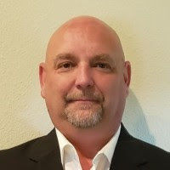
Eastern Region Sales Director
Matthew Selby joined ELPRO on April 6th as our Eastern Region Sales Director
Matthew comes to us from FreeWave Technologies where he has spent the last three years developing and growing a territory three-fold with success in the Oil & Gas, Water/Wastewater and Utilities markets.
Matthew has over 15 years of proven sales experience in the wireless sector where he has engineered, maintained and serviced various solutions in both the licensed and unlicensed spectrum's allowing him to form the trust and reputation our customers demand and deserve.
Matthew is a former U.S. Marine Corps veteran who served in Operation Desert Shield and Desert Storm in Saudi Arabia and Operation Restore Hope in Somalia.
Matthew resides in Tampa Bay, FL and will be contactable via,
Email - matthew.selby@elpro.com.au
Cell - 410 937 4009

Slide 3
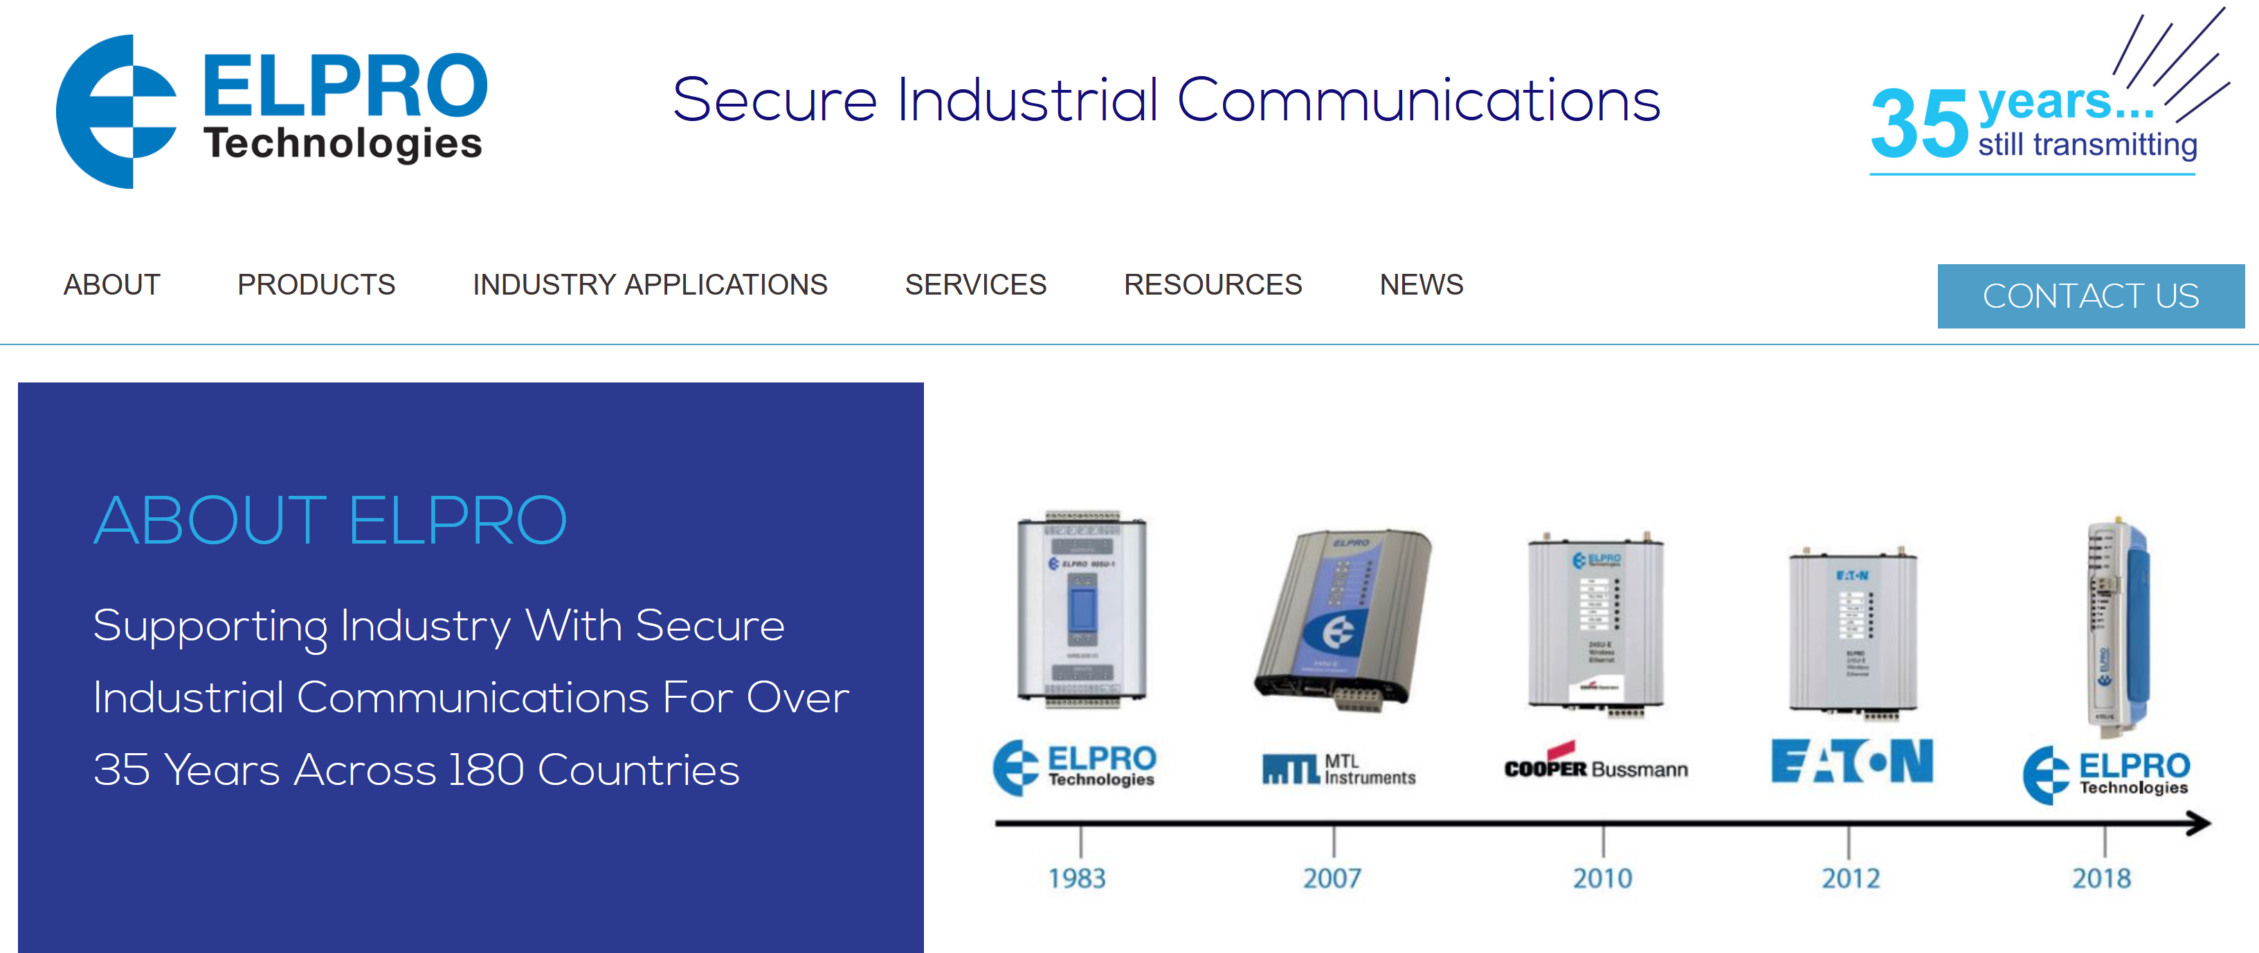
History of ELPRO

Slide 4
History of wireless
The term wireless has been used twice in communications history, with slightly different meaning. It was initially used from about 1890 for the first radio transmitting and receiving technology, as in wireless telegraphy, until the new word radio replaced it around 1920.
Key dates in the History of wireless
1899 – Marconi sent the first international wireless message from Dover, England to Wimereux, France.
1900 – Tesla obtained patents on System of Transmission of Electrical Energy which the US recognized as the first patents on Radio. Tesla is the first person to describe a system of determining the location of an object using radio waves – Radar.
1934 – The Federal Communications Commission (FTC) was created in the US.
1941 – Hedy Lamarr received a patent in 1941, but the enormous significance of their invention was not realized until decades later. It was first implemented on naval ships during the Cuban Missile Crisis
1951- Charles Hard Townes published the principle of the MASER (Microwave Amplification by Stimulated Emission of Radiation).
1969 – The first digital radio-relay system went into operation in Japan using 2 GHz operating frequency. ARPANET was launched (precursor to Internet).
1978 – AT&T Bell Labs started testing a mobile telephone system based on cells.
1980 - In 1980, the FCC authorized the unlicensed use of Spread-Spectrum devices in the 915MHz, 2.45GHz and 5.8GHz bands for industrial, scientific and medical (ISM) bands
1990 – WWW was developed

Slide 5

Invention of Spread Spectrum
Spread Spectrum Background
Invented during WWII as an
anti-jamming tool and to counter
potential interception of messages
A transmitted signal is spread over
a wide frequency band
The benefits of spreading the signal are:
  signal is more immune to noise/interference
  coding and decoding allow simultaneous transmission of multiple signals within the same frequency band
  provides inherent data encryption/security
Hedy Lamarr, FHSS Inventor

Slide 6
Choosing A Radio - Frequency
115 MHZ 450 MHz
900 MHz
2.4 GHz 5GHz
Travels Further (Less need for LoS)
Penetrates Better
Bounces easier
Larger Fresnel Radius
Higher Data Rates (Must be LoS)

Slide 7
Choosing a Radio - Licensed vs Unlicensed
Unlicensed Radios
Free to use after hardware costs
Often have lots of competing traffic (noise)
Must comply to FCC rules
902-928 MHz, 2.4-2.4835 GHz, 5.17-5.835 GHz in USA
Licensed Radios
Requires filing for permit from FCC, associated fees
Customer owns the frequency
Usually less interference, sometimes none at all
Still limited by FCC rules
ELPRO has products for 115 MHZ 435-470 MHz, 900 MHz

Slide 8
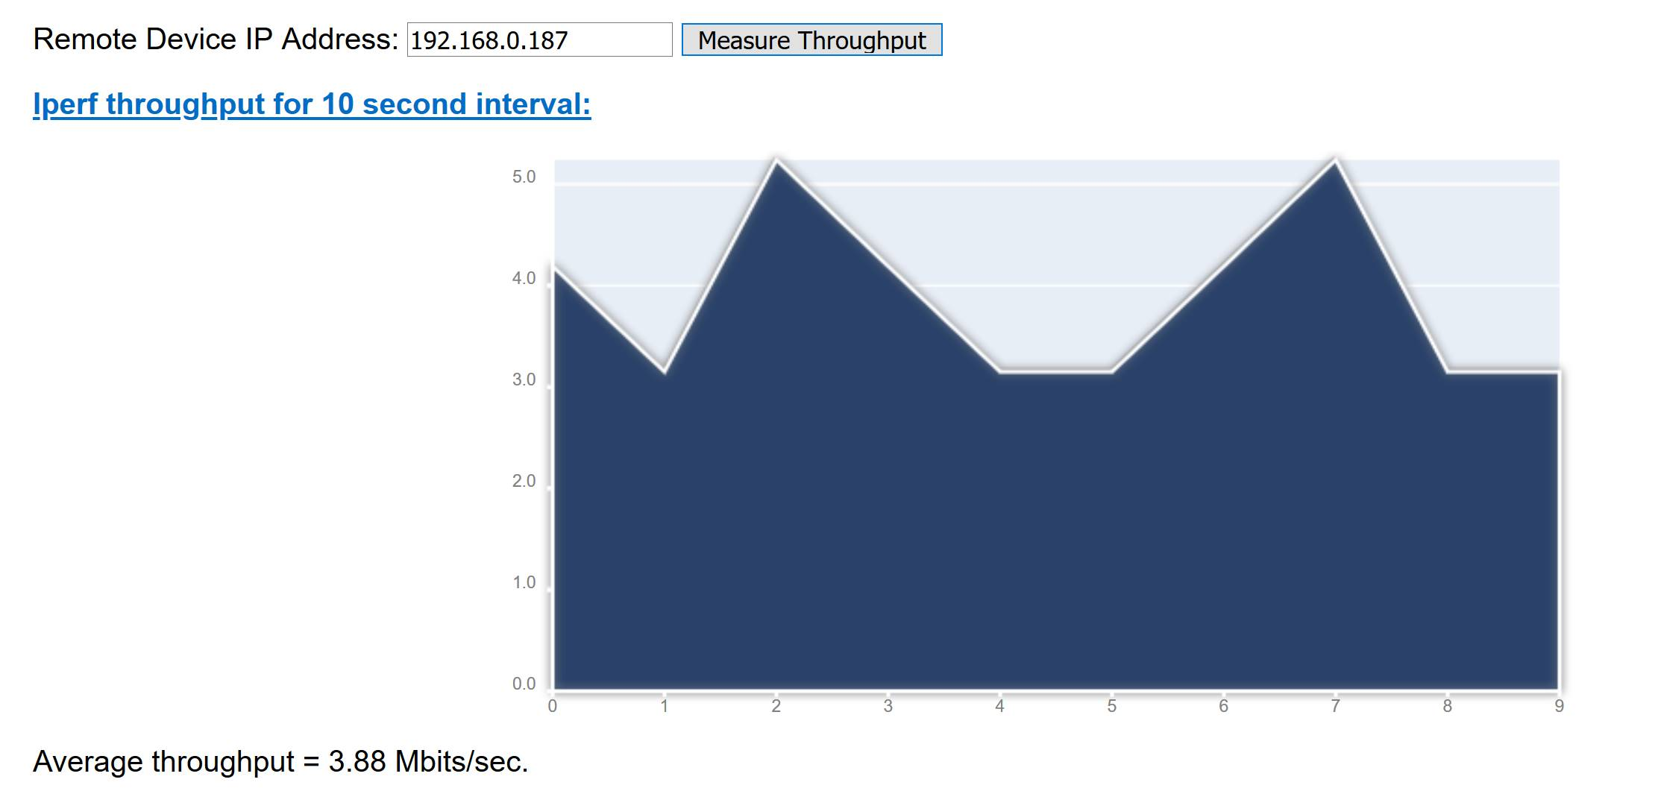
Throughput
Throughput is how quickly data can be pushed through a connection
Determined largely by channel width
Affected by signal strength and noise
Wider channels can accommodate higher throughput, but are also more susceptible to noise
Throughput is ultimate test of network performance in most cases

Slide 9
Spread Spectrum Basics
General Description:
Spread Spectrum Technology
In 1980, the FCC authorized the unlicensed use of Spread-Spectrum devices in the 915MHz, 2.45GHz and 5.8GHz bands for industrial, scientific and medical (ISM) bands
FCC Part 15 rules specify that devices can operate license free in the 900MHz and 2.4GHz band, 1 Watt maximum transmit power from the radio
Two Types of Spread Spectrum
Frequency Hopping (FHSS)
- If a packet is not sent successfully on a given frequency, it is re-sent on another frequency
- Lower throughputs greater range
Direct Sequence (DSSS)
- In a high noise environment, the reliability of the data is dependent on the signal-to-noise ratio
  - There are limits to the amount of noise in the bandwidth that DSSS can handle
  - If there is too much noise on a given frequency, communication will fail
  - Higher throughputs low range

Slide 10
Typical Ranges 900 MHZ FHSS 1W
Distance | Obstructions? | Antenna | Cable | Typical Ant height
1000' | Dense | CFD890EL 2dBi | 16' -2dB | 10'
2000' | Light | CFD890EL 2dBi | 16' -2dB | 15'
5000' | Light | YU6/900 9dBi | 33' -3dB | 20'
10,000' | LOS | YU6/900 9dBi | 33' -3dB | 30'
5 miles | LOS | YU16/900 15dBi | 66' -6dB | 50'

Slide 11
Typical Ranges 945U-E DSSS 630mW
Distance | Obstructions? | Antenna | Cable | Typical Ant height
500' | Dense | CFD890EL 2dBi | 16' -2dB | 10'
1000' | Light | CFD890EL 2dBi | 16' -2dB | 15'
1500' | LOS | YU6/900 9dBi | 33' -3dB | 20'
5000' | LOS | YU16/900 15dBi | 33' -3dB | 30'
5 miles | LOS | YU16/900 15dBi | 66' -6dB | 50'

Slide 12
Typical Ranges at 2.4 GHZ (245U-E-G1-US) DSSS @ 630mW
Distance | Obstructions? | Antenna | Cable | Typical Ant height
100' | Light | MD2400EL 2dBi | 16' -3dB | 10'
500' | LOS | MD2400EL 2dBi | 16' -3dB | 15'
500' | Light | Z2400EL 10dBi | 33' -6dB | 20'
1000' | LOS | PAN2400-12-N 12dBi | 33' -6dB | 30'
1.5 miles | LOS | Y2400-18EL 18dBi | 33' -6dB | 40'

Slide 13
Typical Ranges for 5 GHZ (245U-E-A1-US) DSSS at 630mW
Distance | Obstructions? | Antenna | Cable | Typical Ant height
50' | Light | COL5806 8dBi | 16' -7dB | 10'
250' | LOS | COL5806 8dBi | 16' -7dB | 15'
500' | LOS | COL5810 10dBi | 10' -5dB | 30'
1 miles | LOS | 20dBi panel 20dBi | 10' -5dB | 40'

Slide 14
Typical Ranges for 450 MHz 5W Fixed Frequency
Distance | Obstructions? | Antenna | Cable | Typical Ant height
2000' | Dense | UDP400-C 2dBi | 10' -1dB | 10'
5000' | Light | UDP400-C 2 dBi | 33' -2.5dB | 25'
10,000' | Light | BU3-400 5dBi | 33' -2.5dB | 30'
3 miles | Light | YU3/400 6dBi | 33' -2.5dB | 30'
5 miles | LOS | YU6-400 9dBi | 66' -5dB | 50'
10 miles | LOS | YU9-400 12dBi | 66' -5dB | 60'

Slide 15
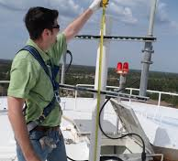
RF Basics
Antennas, Installations and Path Studies

Slide 16
Antenna Basics
An antenna is a device that is made to efficiently radiate and receive radiated electromagnetic waves.
Provides a load for the power amplifier within the radio. (similar to your speakers at home)
There are several important antenna characteristics that should be considered when choosing an antenna for your application as follows:
  Antenna radiation patterns / Antenna type
  Power gain
  Directivity
  Polarization

Slide 17
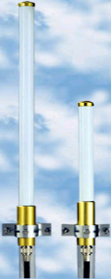
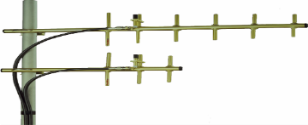
Antenna Types
There are many different types of antennas but primarily the most common in wireless applications are Omni and Yagi antennas

Slide 18
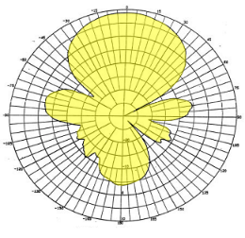
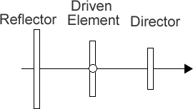
Yagi Antennas
Yagi antennas consist of an array of independent antenna elements to focus the radiated power in one general direction, with only one of the elements driven to transmit electromagnetic waves.
The number of elements (specifically, the
number of director elements) determines the gain and directivity.

Slide 19
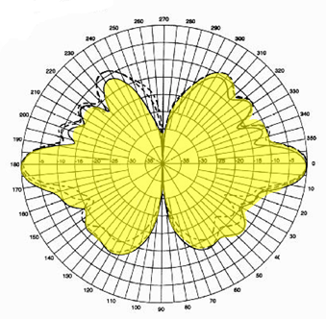
Omni Antennas
Omni antennas have a generalized radiation pattern. Its power is equally split through 360 degrees around the antenna.

Slide 20

Antenna Gain
The power gain of an antenna is a ratio of the power input to the antenna to the power output from the antenna. This gain is most often referred to with the units of dBi, which is
logarithmic gain.
Antenna gain and transmit power can be traded off. For example, doubling one antenna gain has the same effect as doubling the transmitter power. Doubling both antenna gains has the same effect as quadrupling the transmit power.
High gain = greater distance = larger antenna

Slide 21
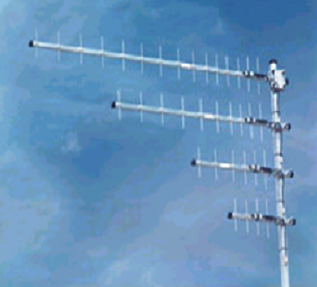

Directional
Direct almost all power in one direction
Higher gain antennas direct power into a tighter beam
Direction of Main beam
Main Lobe
Minor Lobes
Typical Antenna Gains
16 Element 15dBd
9 Element 12dBd
6 Element 9dBd
3 Element 6dBd

Slide 22
Antenna Polarization
Polarization is the orientation of electromagnetic waves from the source. The two most common types of polarization are Vertical and Horizontal.
Polarization is most important if you are trying to get the maximum performance from the antennas. For best performance you will need to match up the polarization of the transmitting antenna and the receiving antenna.

Slide 23
Cabling to the Antenna
For each radio installation, consideration should be given to cable loss. For example, if LMR 400 is used on a 200ft Tower, loss in cable alone is 8dB.
Cable Product | Attenuation (dB/100 ft) | Run Length (Ft) | Total Run Attenuation (dB)
LMR 400 | 3.93 | 25 | 1
LMR 500 | 3.154 | 25 | 0.8
LMR 600 | 2.518 | 25 | 0.6
LMR 900 | 1.709 | 25 | 0.4

Slide 24
Rules of the Game
FCC permits 1 Watt (30dBm) at Radio and 4 Watts (36dBm EIRP) at Antenna
Formula:
Radio Output – Losses* + Antenna Gain = Output at Antenna
30dBm – 2 dB + 6dBi = 34dBm (or 2.5 Watts**)
What would happen if a 10dBi Yagi was used?
30dBm – 2 dB + 10dBi = 38dBm (or 6.3 Watts)
* Losses include Cable, Connectors,
Surge Protectors, etc.
**dBm = log10 (mW)*10
1000 milliwatts = 1 Watt

Slide 25
Rules of the Game – “10s and 3s of RF Math”
Important:
- 3 dB = half the power in mW
+ 3 dB = double the power in mW
- 10 dB = one tenth the power in mW
+ 10 dB = ten times the power in mW
In other words:
- 3 dB = divide mW power by 2
+ 3 dB = multiply mW power by 2
- 10 dB = divide mW power by 10
+ 10 dB = multiply mW power by 10

Slide 26
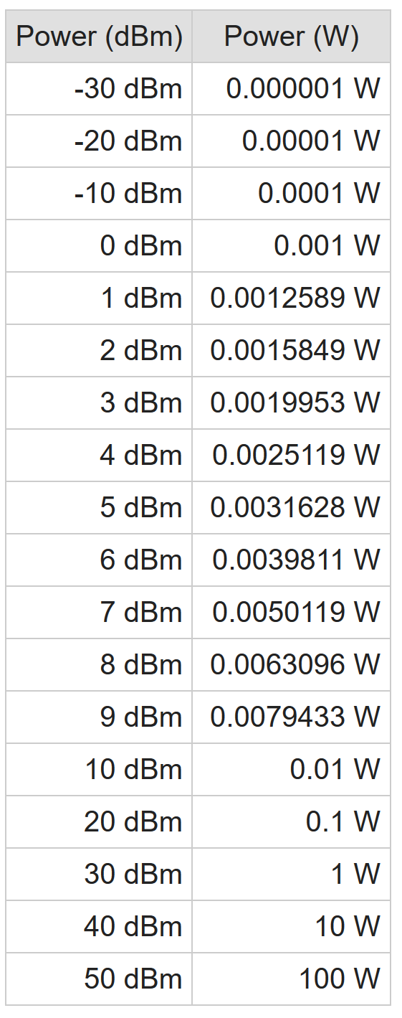

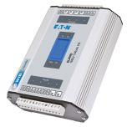
How dB calculations work
Final Signal Strength at RX Radio = -70dBm
  TX Radio Transmit Power = 1W = +30dBm
  - TX Antenna Cable Losses -4dB
  + TX Antenna Gain +5dB
  - Signal Strength Losses Over Distance -100dB
  + RX Antenna Gain +5dB
  - RX Antenna Cable Losses -6dB
Example numbers
If the threshold of reception of the receiver is -110dBm, this will work.
TX
RX

Slide 27
Rules of the Game
The ELPRO 915U radio can transmit at a maximum of 30 dBm which equates to 1 Watt [1000 mW].
Scenario 1
If we connected a 10 dBi Yagi antenna directly to the 915U [no loss in cable, no loss in connectors], what would our EIRP be in dBm and Watts [or mW]?
Answer
30 dBm [Radio] + 10 dBi [Yagi] – 0 [Cable Loss] = 40 dBm
And, from the previous slide we know that for every 10 dBm of gain we also see 10 times the power in mW. So, if we take 1000 mW times 10 we see that this equates to 10000 mW [aka 10 Watts]

Slide 28
Rules of the Game
The ELPRO 915U radio can transmit at a maximum of 30 dBm which equates to 1 Watt [1000 mW].
Scenario 2
If we connected a 9 dBi Yagi antenna directly to the 915U[no loss in cable, no loss in connectors], and turned our transmit power of the 915U down to 500 mW what would our EIRP be in dBm and Watts [or mW]?
Answer
First, we need to convert 500 mW into dBm. We know that at full output power the radio is at 30 dBm or 1000 mW. We know that for every -3 dB we cut our mW power in half. So, in this scenario our mW power is cut in half (was 1000 mW, now 500 mW) therefore we conclude that our dBm must be 27 (30 – 3 dB = 27).
27 dBm [Radio] + 9 dBi [Yagi] – 0 [Cable Loss] = 36 dBm [4 Watts]

Slide 29
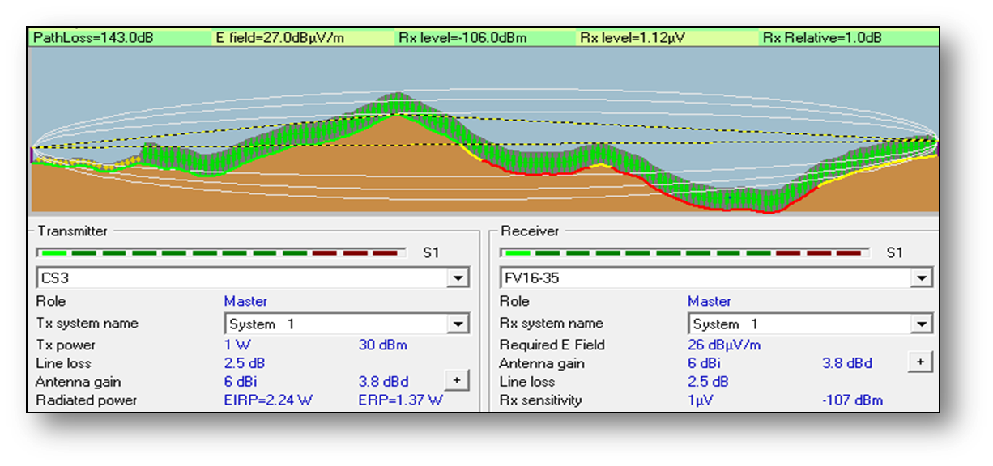
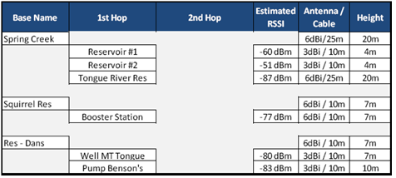
Site Survey
Complete a Site Survey
Include a Google Earth .kmz file
Include all available tower heights
Include all obstacles and heights including trees and buildings
Use correct format of coordinates:
  98 65 23.5666 or 98.656566665
  DD.dddd or DD MM SS.ssss
Email form to Include Master location and potential Repeater sites to Brian
Brian.Cunningham@elpro.com.au

Slide 30
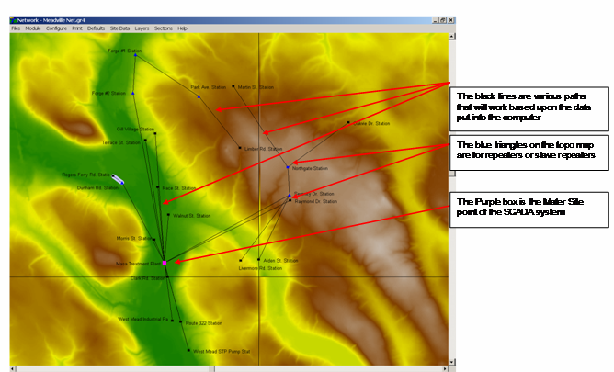
Topo Map

Slide 31
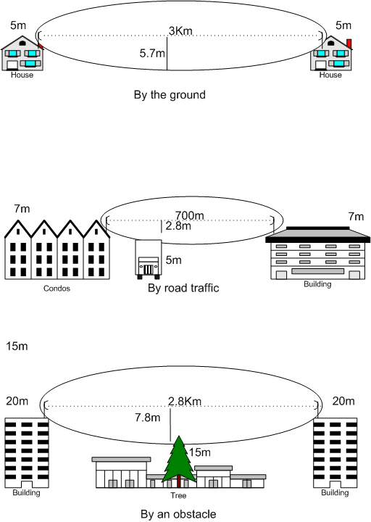
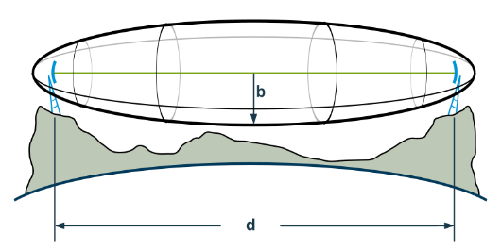
Path Study Basics – Fresnel Zone
Fresnel Zone
d is the distance between the transmitter and the receiver
b is the radius of the Fresnel zone.

Slide 32
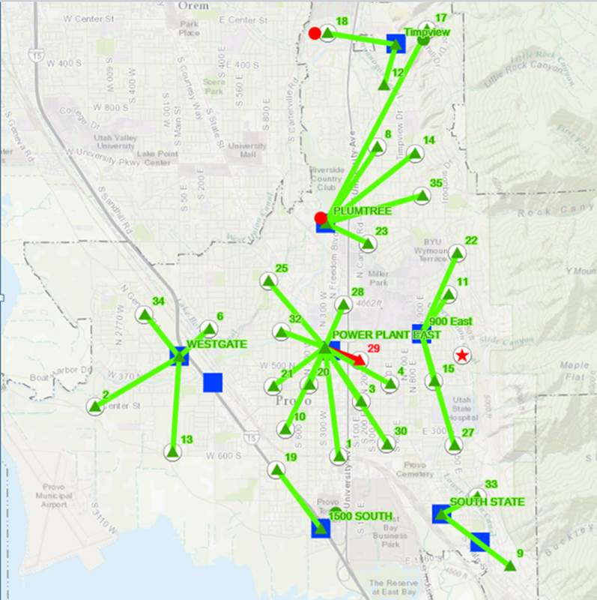
Network Design (example)
Square – Master radio /Headend
Triangle – Repeater site
Circle – End point

Slide 33
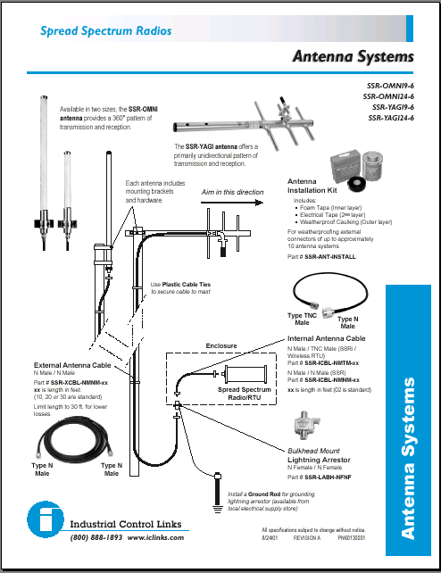
Install Cables & Antennas Properly
Installation Basics
Equipment List
Proper Antenna
Coax Cable
Lightening Arrestor
Grounding Rod
Grounding wire and Clamp
NEMA-4 Enclosure
Interior cables, Data and Power
Mounting Bracket
Radio

Slide 34
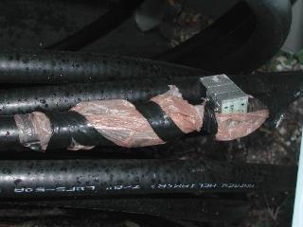
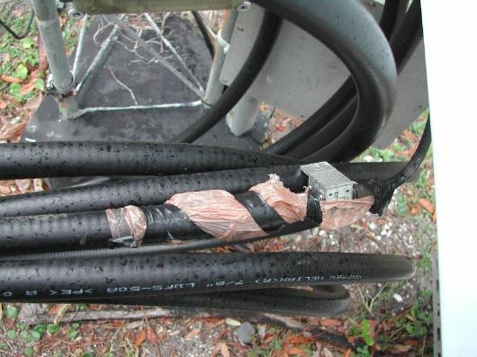
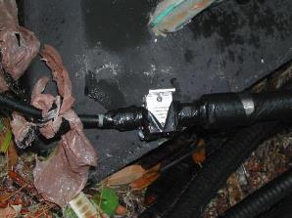
What Not To Do
Installation Basics

Slide 35
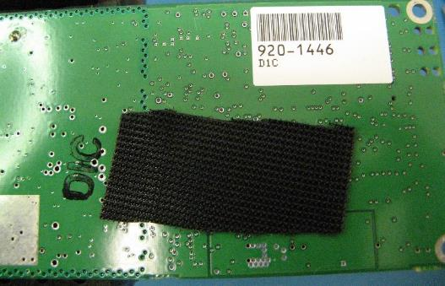
DO NOT USE VELCRO TO MOUNT A RADIO
Installation Basics
Using velcro is a bad installation practice because it creates an ESD hazard.
Mounting a radio to a metal surface with velcro creates the possibility of shorting out the radio.

Slide 36
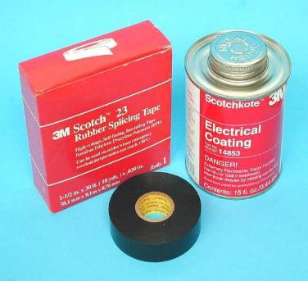
Installation Kit
Installation Basics
All exterior cable connections MUST be waterproofed using these tools
1st Wrap connectors in foam, or mastic tape
Next wrap with electrical tape
Now coat the connection with Electrical Coating

Slide 37
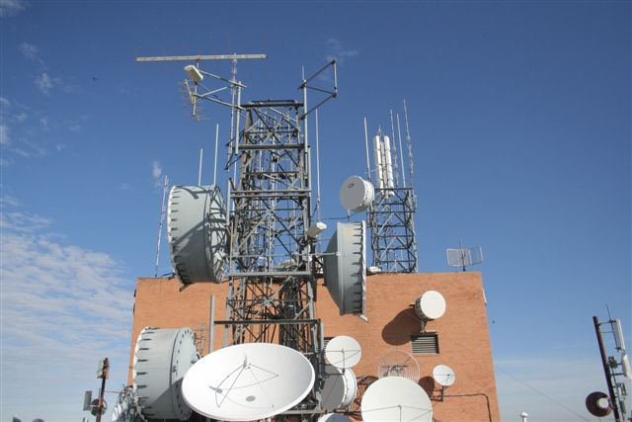
Cheap Isn’t Always Best – Investigate Your Infrastructure Options! – Antenna Separation

Slide 38
Antenna Separation Requirements
Vertical Separation Requirements
 | 150. MHz | 220. MHz | 450. MHz | 900. MHz | 2400. MHz
150. MHz | 78 ft | 60 ft | 45 ft | 32 ft | 25 ft
220. MHz | 60 ft | 40 ft | 10 ft | 22 ft | 16.4 ft
450. MHz | 44 ft | 30 ft | 20 ft | 15 ft | 11 ft
900. MHz | 33 ft | 22 ft | 15 ft | 10 ft | 7.5 ft
2400. MHz | 25ft | 16.4ft | 11 ft | 7.5 ft | 5 ft
Either Vertical or Horizontal Separation is Required
As shown on the left, vertical separation is 10 times more effective
Horizontal Separation Requirements
 | 150. MHz | 220. MHz | 450. MHz | 900. MHz | 2400. MHz
150. MHz | 780 ft | 600 ft | 450 ft | 320 ft | 250 ft
220. MHz | 600 ft | 400 ft | 100 ft | 220 ft | 164 ft
450. MHz | 440 ft | 300 ft | 200 ft | 150 ft | 110 ft
900. MHz | 330 ft | 220 ft | 150 ft | 100 ft | 75 ft
2400. MHz | 250 ft | 164 ft | 110 ft | 75 ft | 50 ft

Slide 39
Antenna Mounting Guidelines
Antennas need to be mounted up high (for Fresnel clearance and to clear obstructions)
Mount 1 wavelength away from any wall
Ensure no obstructions immediately in front of antenna
Ensure metal surfaces not immediately in front and directly in path
Away from other antennas

Slide 40
Lightning Arrestors
The coaxial RF surge protector (also known as radio frequency lightning surge protector or lightning surge arrestor or suppressor) protect against electromagnetic pulse (EMP), high-altitude EMP (HEMP) or power surges that are commonly caused by lightning or other strong electrical changes. Coaxial radio frequency surge protector products are commonly used for radio and antenna installations where part or all equipment is outdoors. This system is to protect sensitive equipment and are specially designed to pass the desired frequency while suppressing DC surge.

Slide 41



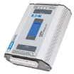



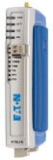





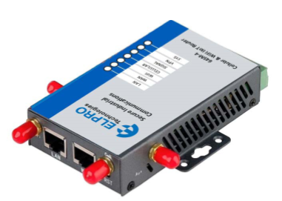


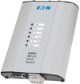
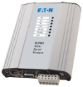
ELPRO Product Line
Next Generation I/O
Mesh IO
900MHz / 2.4GHz
Unidirectional
869/900MHz
Transceiver
150-512/869/900MHz
Unidirectional
869/900MHz
Expansion I/O
Remote I/O
415U-2
215U-2 / 915U-2
105/905U-L-T/R
105/905U-1,2,3,4
505/905U-K
115S/ 115E-2
DNP3 Outstation
Modbus TCP/RTU
(Master /Slave)
Ethernet IP,
Modbus TCP/IP
Modbus RTU,
DF1
Profibus DP
(Master /Slave)
Modbus Plus (Slave)
Gateways
DNP3-TCP
415/215/915U-2
105/905U-G-ET1
105/905U-G-MD1
105/905U-G-PR1/2
105/905U-G-M+1
340-480 MHz
869/900 MHz
900 MHz
802.11b/g
@ 2.4 GHz
802.11a
@ 5.8 GHz
Ethernet
Switches
Cellular
“NEW” Cellular
Ethernet
415U-E
805/905U-E
945U-E
245U-E-G
245U-E-A
1050/2080/5073-E-T
615M-1
645M-4-4G
869/900 MHz
60 MHz
150-512 MHz
Serial
805/905U-D
455U-D
455U-D

Slide 42
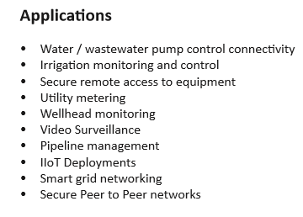
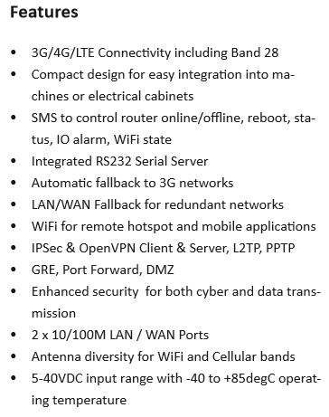
645-4 4G/LTE Cellular WiFi Modem and Router
Secure Industrial Cellular and WIFi connectivity for IIoT applications
NEW!

Slide 43
EL 415U-1-C
Description
ELPRO industrial wireless has 30 years of expertise in solving critical industrial applications through our extensive knowledge in wireless I/O, modem and gateway applications. The 415U-1-C extends communications to sensors in local, remote, and difficult-to-reach locations where AC power is not available.
Designed with the Condor series long-range, high data speed wireless transceiver and standards-based native Ethernet protocol over the air, 415U-1-C has the power and flexibility to perform reliably in sprawling harsh industrial environments.
The 415U-1-C is specifically designed for use in applications that are unattended for long periods, years.
Secure. AES encryption, multi-level authentication, user access and change event logging features provide the user with the tools to ensure the highest level of data integrity and protection against malicious attacks.
Flexible. Integrated inputs, alarm output, SDI-12 for sensors and modbus RTU expansion give the ELPRO 415U-1-C the ability to solve a large number of industrial monitoring challenges.
Reliable. The Condor series 415U-1-C ProMesh operates reliably with the challenges of obstructed paths by using automatic path selection and frequency agility to allow the communications network to adapt to changes easily with redundancy.
Applications
• Water and wastewater: flows, levels, pumps
• Renewables—solar farms, wind turbines, hydro
• Irrigation: slew gate controls, levels
• Oil and gas networks: gas well production, lift pump
• Environmental: storm warning, smoke stacks, filters
• Mining infrastructure: conveyor, re-claimer, pumps

Slide 44
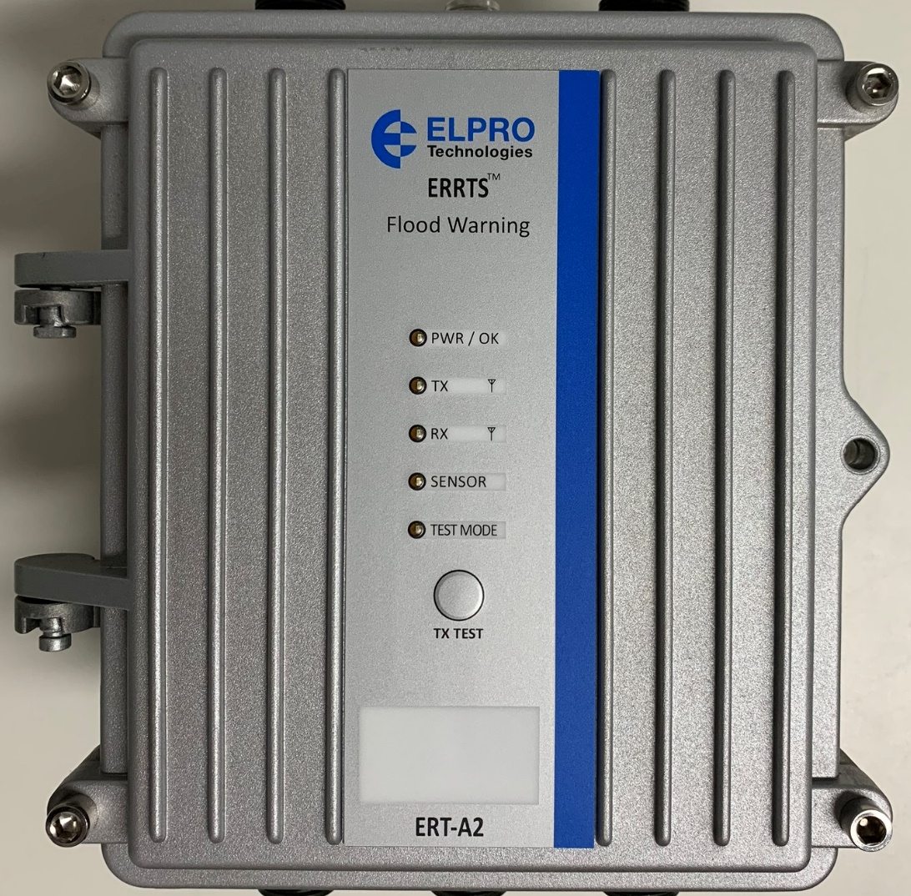








ERT-A2 Battery powered Environmental Monitoring
Release June 2020
NEW!
Wireless
Licenced Cell/Sat
Flexible
Field Stn
Rptr/Rx’r
Logging
Inputs/Config
Robust
Enclosure
150/450MHz License or license free
Cellular LTE/4G
Satellite
Configurable as field, repeater or receiver station
Internal or external IO
User access, config changes
IP66 Enclosure
Extended operating Temperature Range
Inputs
Pulse/Analog
Sensors
SDI-12
Power IN
Pb, LiFe, Li-P
Charging
DC IN
Solar
4 Discrete on/off or pulsed
2 Analog 4-20mA/0-5V
Environmental Smart Sensors
Max 62, 2/3 wire sensors
12Vdc switched supply
Dual chemistry
Internal lithium
External lead acid
External DC input 15-30Vdc
Solar charge up to 30W panel
Max charge 2A

Slide 45
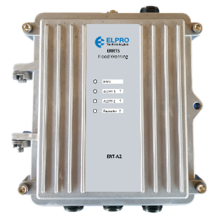
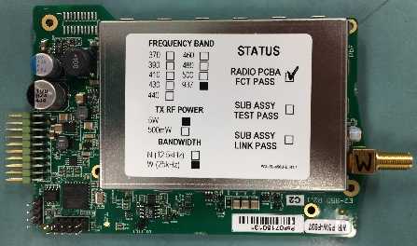
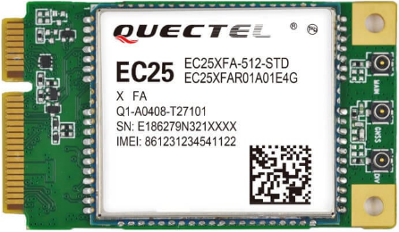
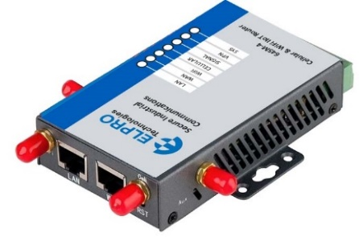
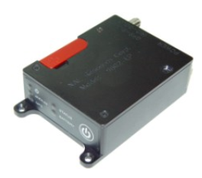
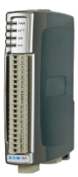



ERT-A2 Features - Communications Connectivity
Flexible platform that can communicate ALERT2 data over a variety of communications media
Traditional VHF radio or IIOT applications
Can combine VHF with Cell or Sat modem in network extension applications
RS-485 to ERT-A2 Rx’er
ALERT2 Decoder
BOM HFEM/HyData
Logging
FTP to cloud IOT
Gateway DNP/Modbus
VHF 5W
VHF 25W PA option
UHF 10W
4G/LTE/IOT-NB comms
Lower cost
Compatible for Condor
Door mount 4G/LTE Cell
Gateway VHF/Cell
Camera Gateway
Satellite
RS485 data/door mount
Gateway VHF/Satellite
Internal Communications options

Slide 46
Conclusion
Better understanding of RF Basics for choosing a frequency for your network
Antenna properties and Installation best practices
Sneak peak of ELPRO’s future products

Slide 47
Questions
?

Slide 48
The End
THANK YOU

Slide 49

35+ Years and Still Transmitting!

