Slide 1


Underwater Ultrasonic Interface Level Measurement
(It’s Not Just About Sludge Blanket Anymore)
Gilson Engineering
May 8, 2020
Michael Emmanuel
ATI-Entech Design

Slide 2
Underwater Ultrasonic Interface Level Measurement
(It’s Not Just About Sludge Blanket Anymore)
      Interfaces
        Sludge
        Filter Media
      How they work
      Examples and Benefits
        Sludge Blanket Monitors
        Filter Backwash Monitor
      Installation Configurations

Slide 3
What is an “Interface”?
Interface - a SURFACE regarded as the common boundary of two bodies, spaces, or phases. ~ Webster

Slide 4
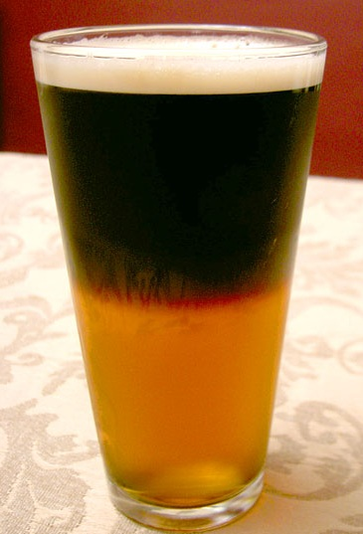
Where’s the Interface?

Slide 5
Where’s the Interface?
Foam/Air
Foam/Dark
Foam/Glass
Glass/Dark
Glass/Air
Dark/Light
Table/Air
Light/Glass
Glass/Table

Slide 6
Some Common Interface
Measurement Methods in Water and Wastewater Plants

Slide 7
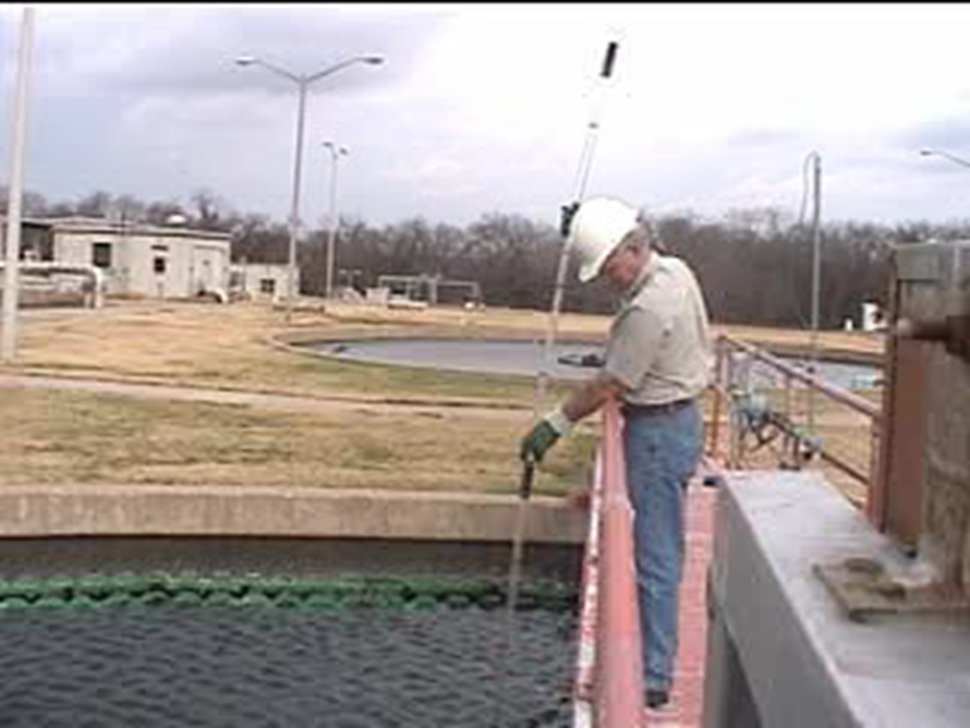
“Sludge Judge”

Slide 8
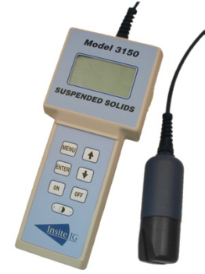
Portable TSS Meter
Smart, Flexible, Friendly!

Slide 9
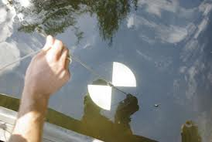
Secchi Disk
Smart, Flexible, Friendly!

Slide 10
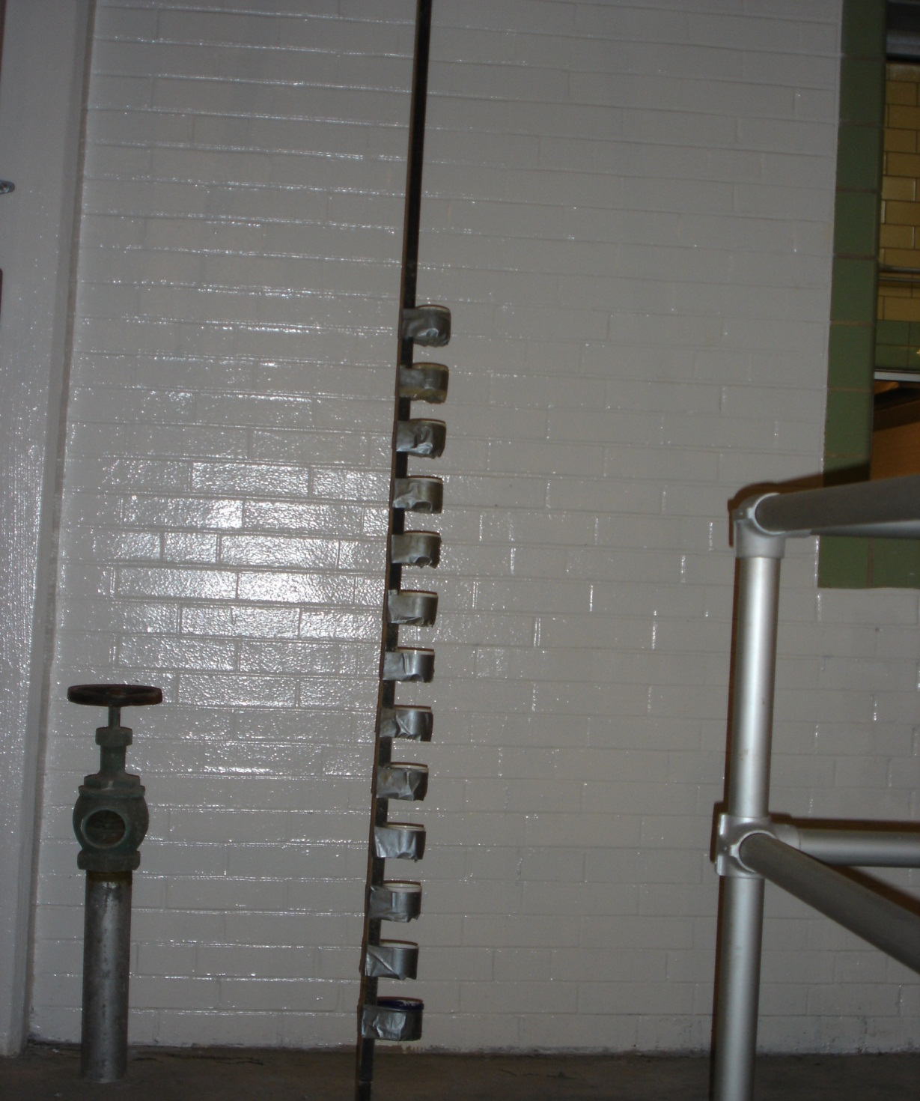
Media Expansion: “Cups On a Stick”
Smart, Flexible, Friendly!

Slide 11
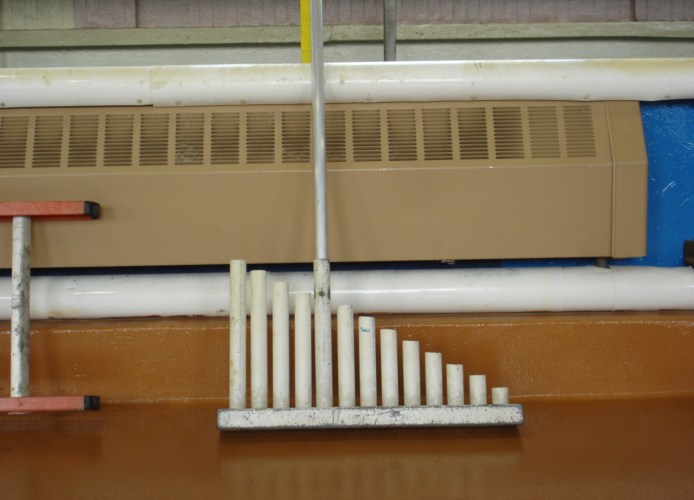
“Organ Pipes” or “Pan Pipes”
Smart, Flexible, Friendly!

Slide 12
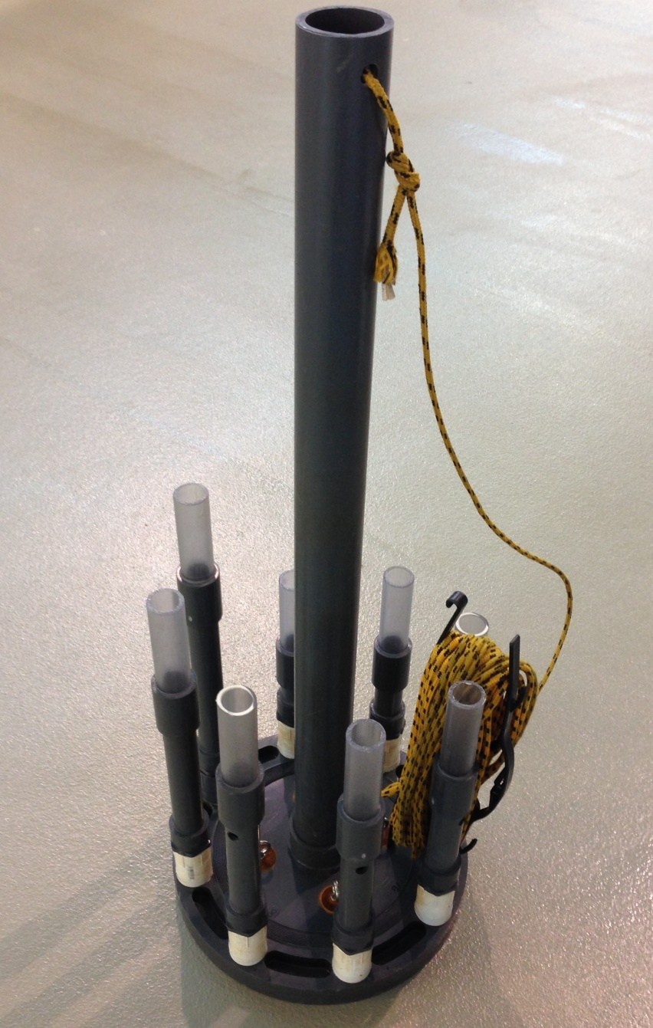
Spiral Pan Pipes
Smart, Flexible, Friendly!

Slide 13
Questions?
Smart, Flexible, Friendly!

Slide 14
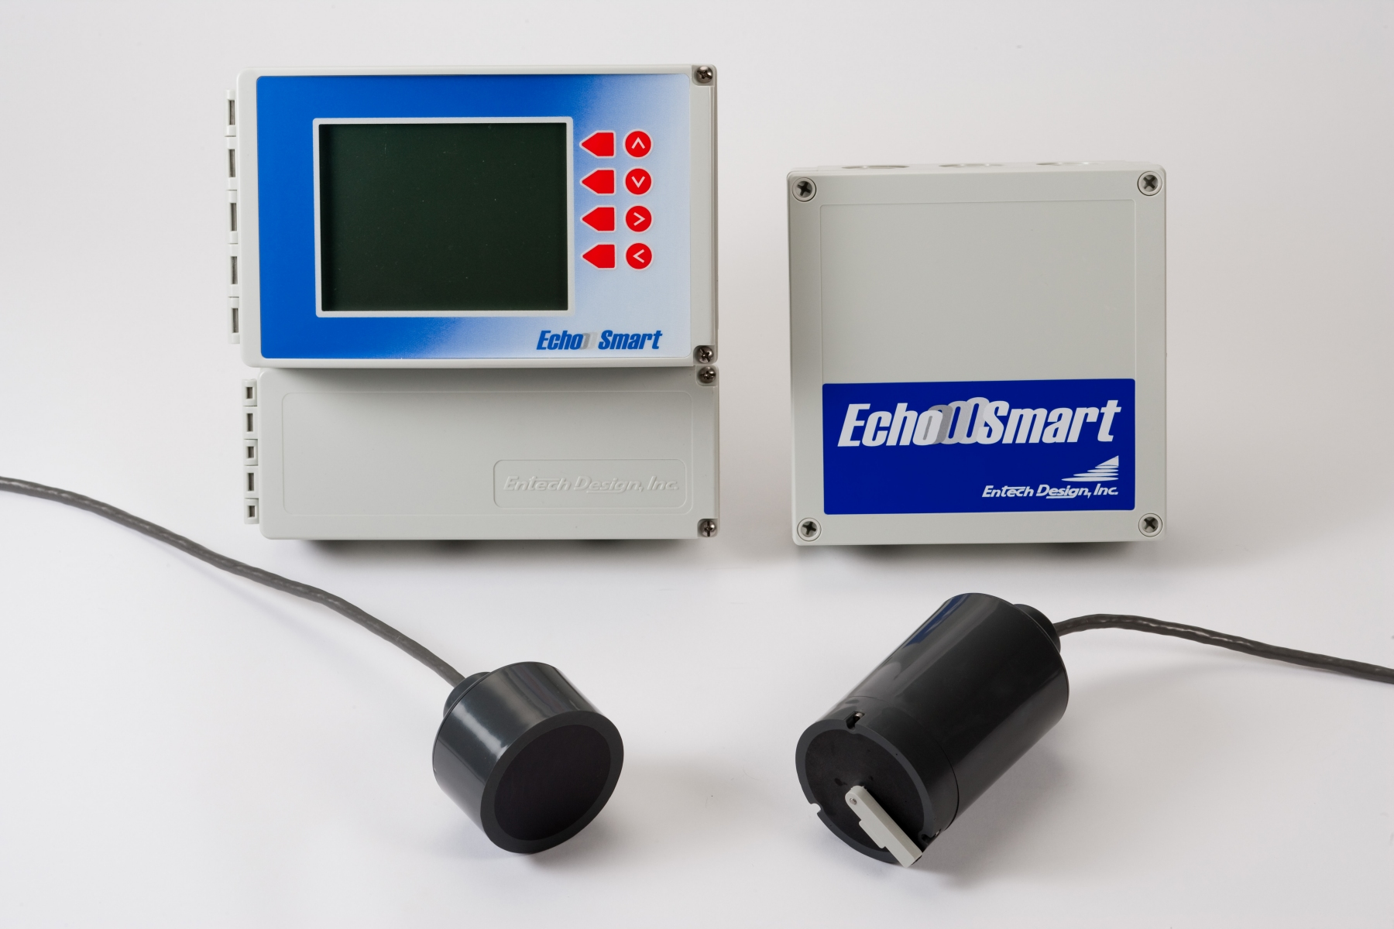
Why Continuous Monitoring?
These Guys Are Working 24/7/365
Smart, Flexible, Friendly!

Slide 15
How Do They Work?
Smart, Flexible, Friendly!

Slide 16
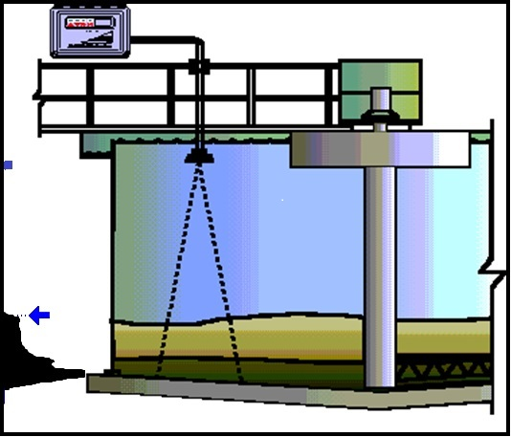
How Do They Work?
(Sludge & Media Level)
Measurement Technique:
Underwater Ultrasonic
(756KHZ)
Time of Flight
d = vt
Unit of Measurement:
M, Ft. , Inches, cm
Smart, Flexible, Friendly!

Slide 17
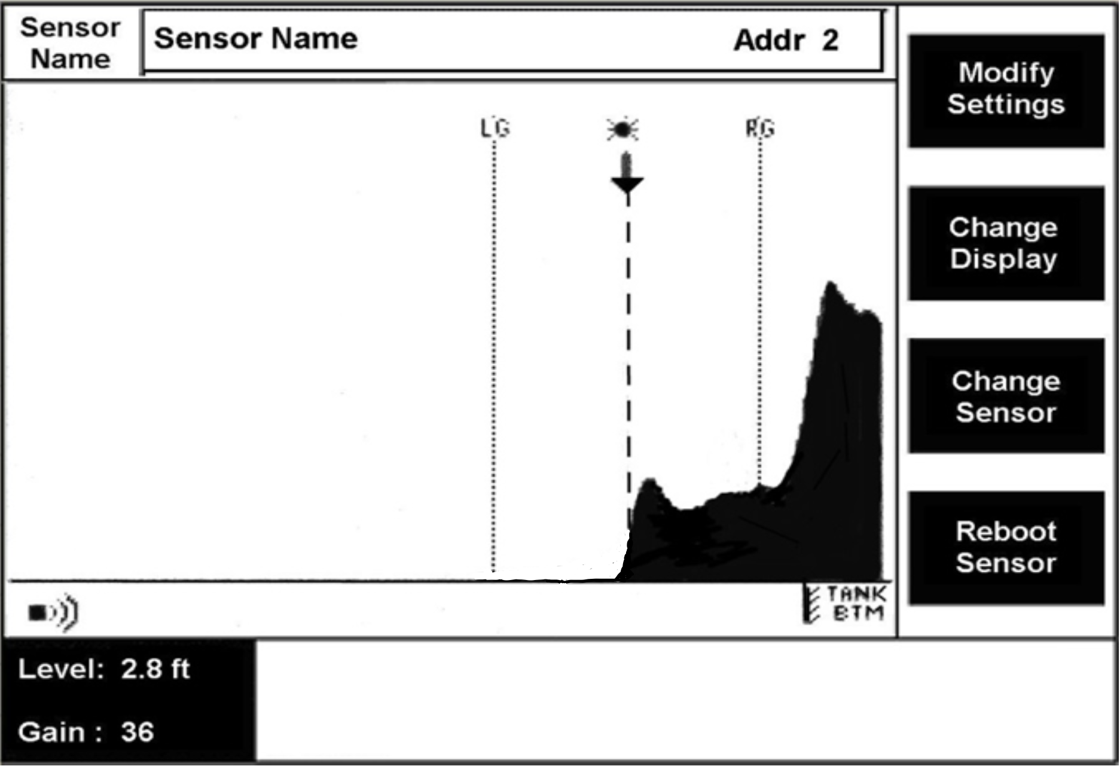
Echo Profile of Well-Settled Sludge Blanket
Smart, Flexible, Friendly!

Slide 18
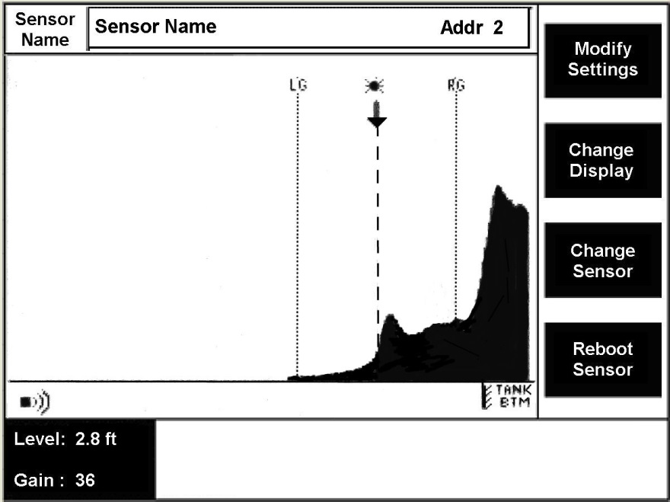
Echo Profile of Not-So-Well-Settled Sludge Blanket
Smart, Flexible, Friendly!

Slide 19
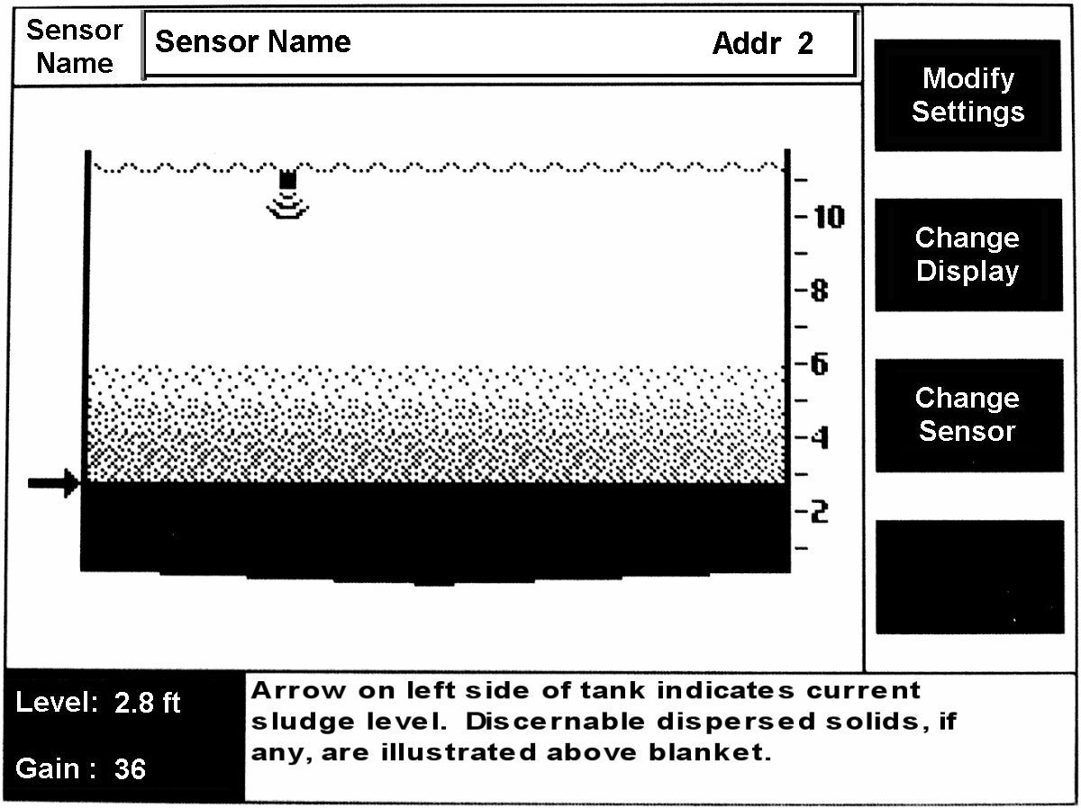
Circular Tank Profile
Smart, Flexible, Friendly!
Notes:
Graphics view – usually the screen used in day to day plant operations

Slide 20
Circular Tank Profile
Second Output Available for ‘Fluff’ or ‘Rag’ Layer
Smart, Flexible, Friendly!
Notes:
Graphics view – usually the screen used in day to day plant operations

Slide 21
Questions?
Smart, Flexible, Friendly!

Slide 22
Examples and Benefits of Continuous Monitoring
(Snapshots vs. Video)

Slide 23
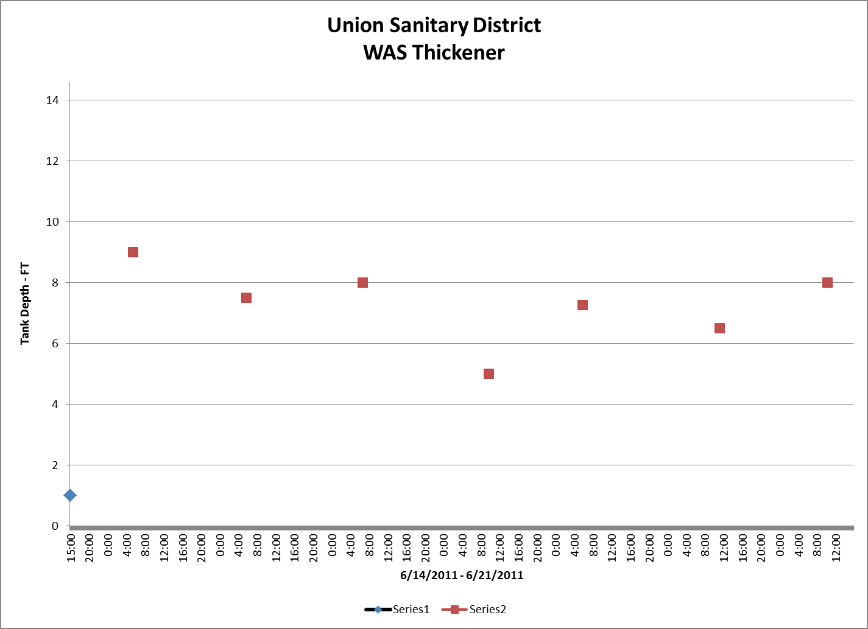
Snapshot vs. Continuous Monitoring

Slide 24
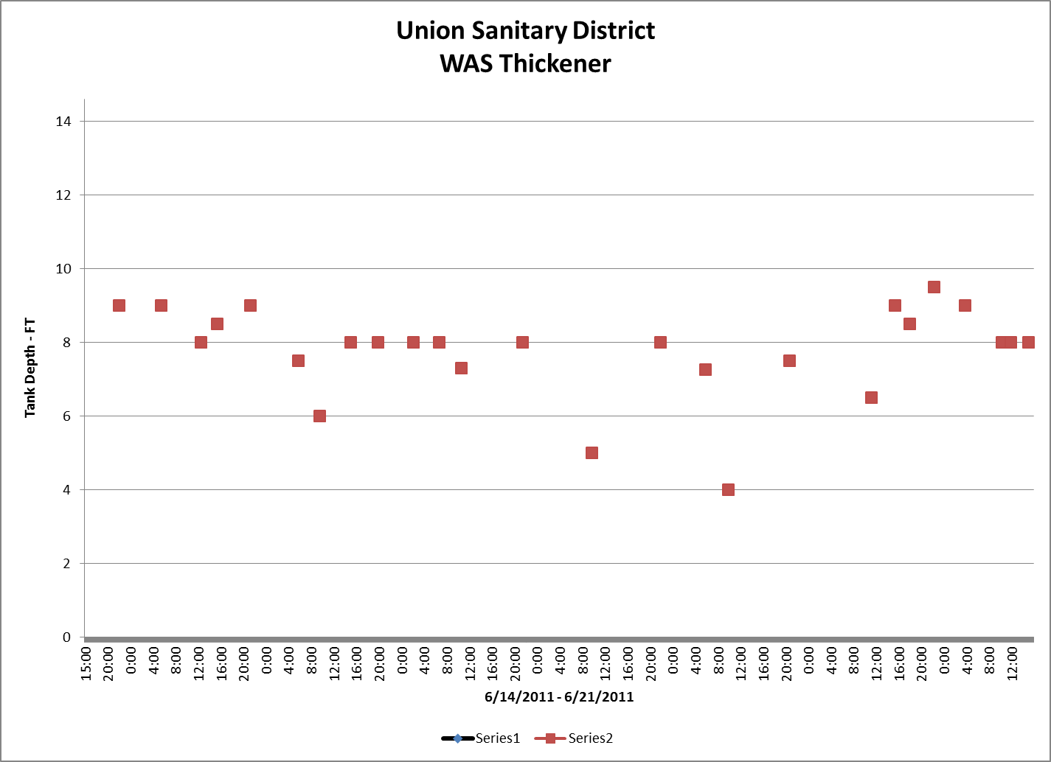
Snapshots vs. Continuous Monitoring

Slide 25
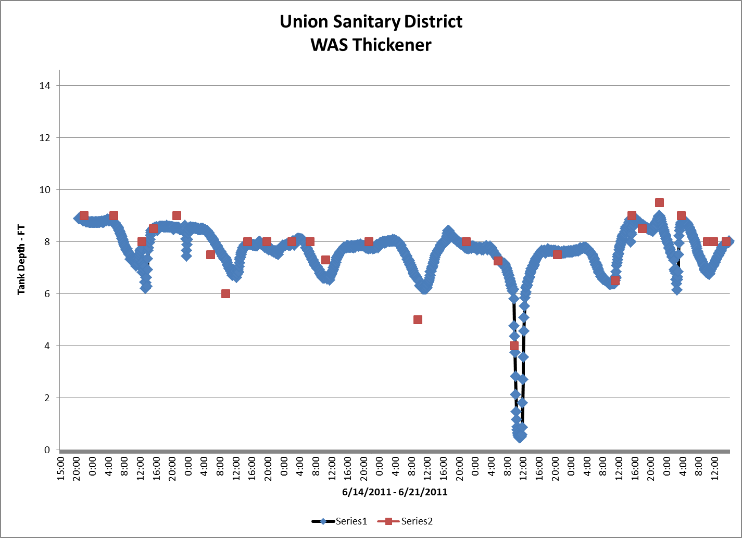
Snapshot vs. Continuous Monitoring

Slide 26
Benefits of Continuous Monitoring
Smart, Flexible, Friendly!

Slide 27
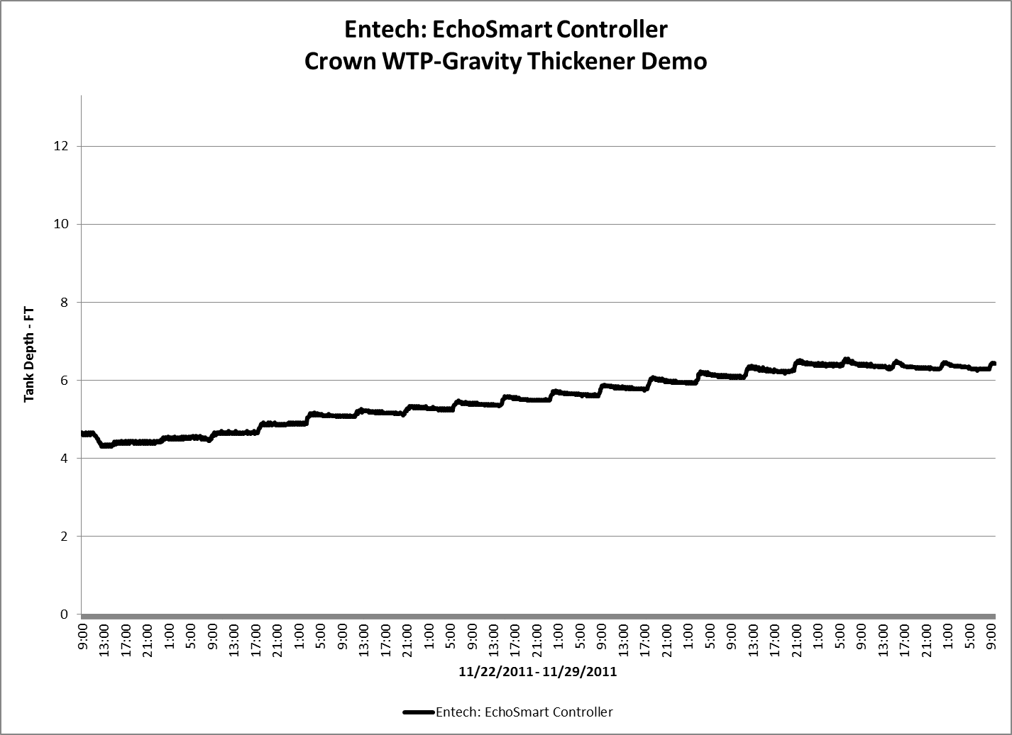
Benefits of Continuous Monitoring
Smart, Flexible, Friendly!

Slide 28
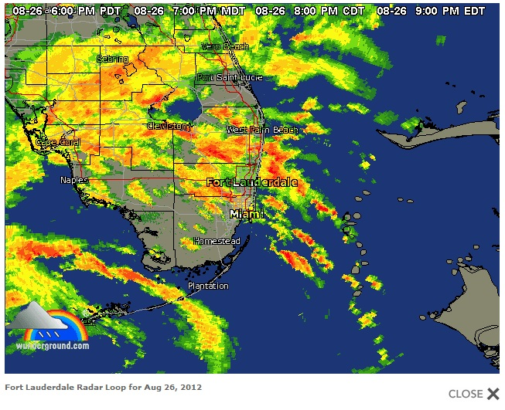
Reliability

Slide 29
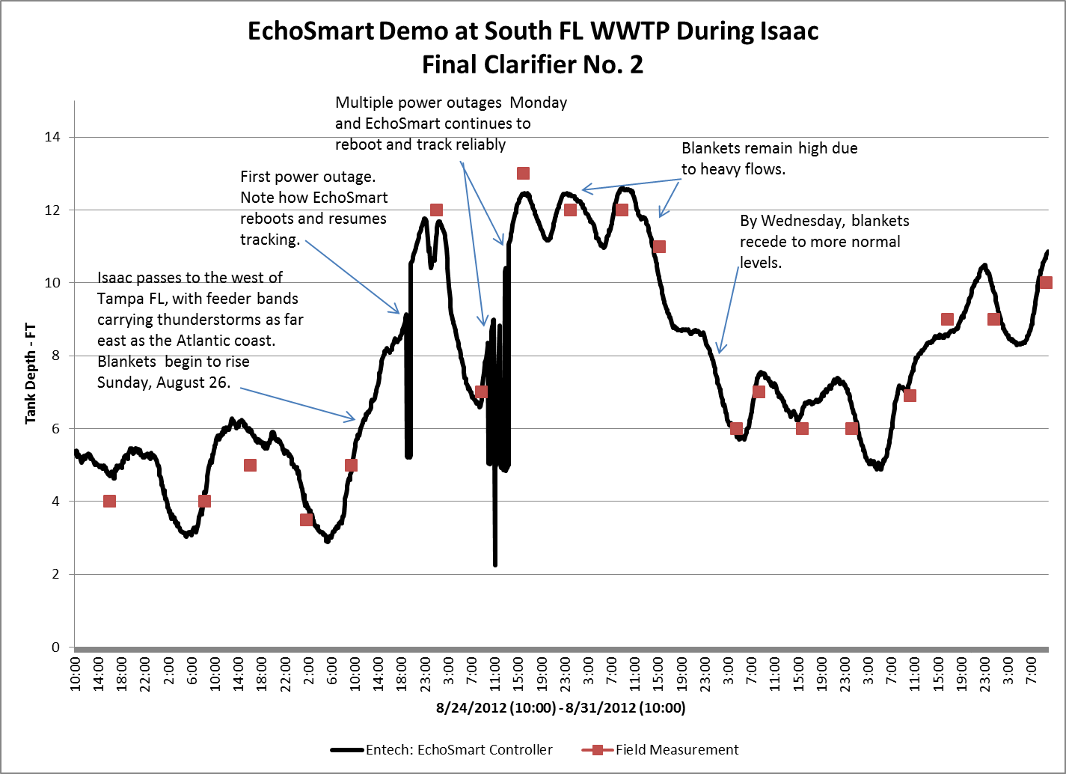
Reliability

Slide 30
Benefits of Sludge Blanket Monitors
Continuous Monitoring Even in Bad Weather
Trend Data in SCADA
Trends Provide Feedback on Settling Conditions
Optimize RAS and WAS Pumping
Maximize Underflow Concentration & Prevent Solids Washout
Generate Warnings and Alarms
Minimize Human Exposure to Unsanitary Process Environments In WWTPs
Reliability and Confidence
Compare Trends - Gain Insights
Smart, Flexible, Friendly!

Slide 31
Questions?
Smart, Flexible, Friendly!

Slide 32
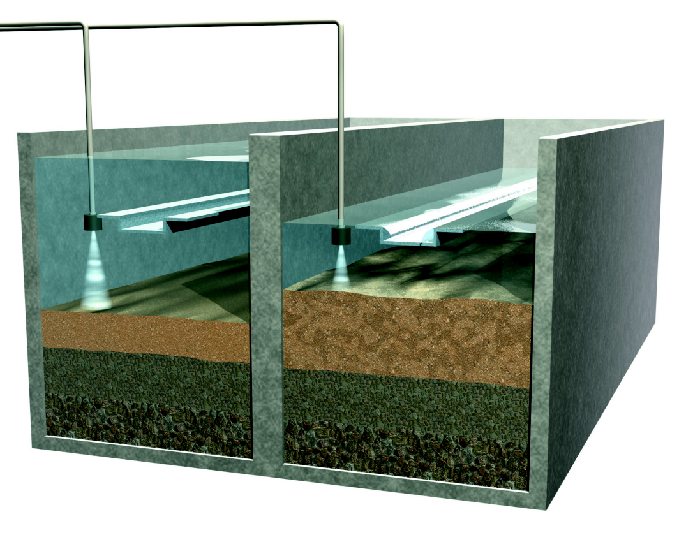
In-Filter Monitoring Of
Media Expansion and Turbidity
FILTERING
BACKWASHING
Smart, Flexible, Friendly!

Slide 33
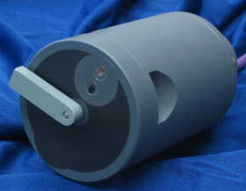
Level & Turbidity Sensor
Measure Media Level and Turbidity In the Filter
Optimum Expansion
  PLUS
Optimum Duration
Equals
Optimized Backwash!
Smart, Flexible, Friendly!

Slide 34
How Do They Work?
Turbidity
Sample
Measurement Technique:
In-Situ Turbidity Measurement
90 Degree Scattered Light Turbidity Sensor
Unit of Measurement:
NTU
Undisolved Material
Incident Light
Infrared LED Light Source
Filter
Photodiode Receptor
Turbidity Value

Slide 35
They Work Pretty Well

Slide 36
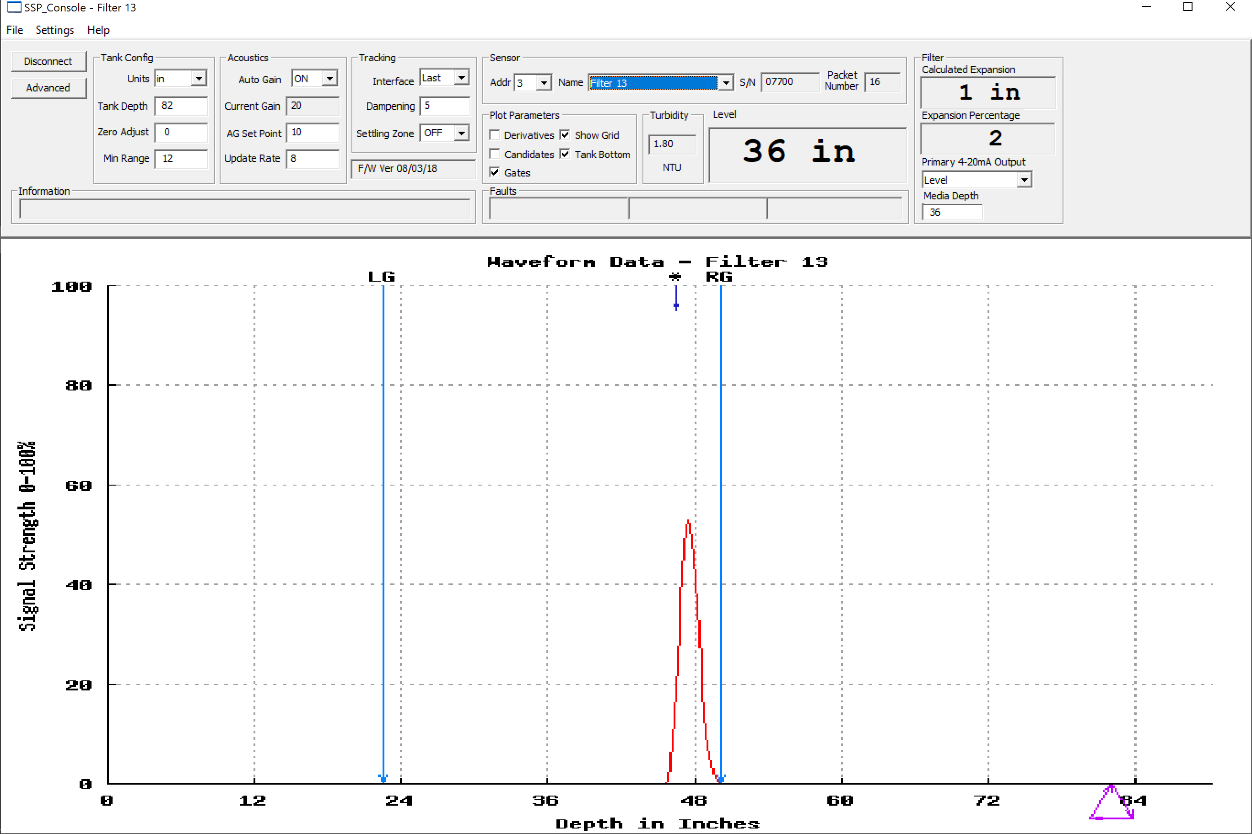
Echo Profile of Filter Monitor
Smart, Flexible, Friendly!

Slide 37
Anatomy of a Backwash
FILTERING
BACKWASHING
Smart, Flexible, Friendly!

Slide 38
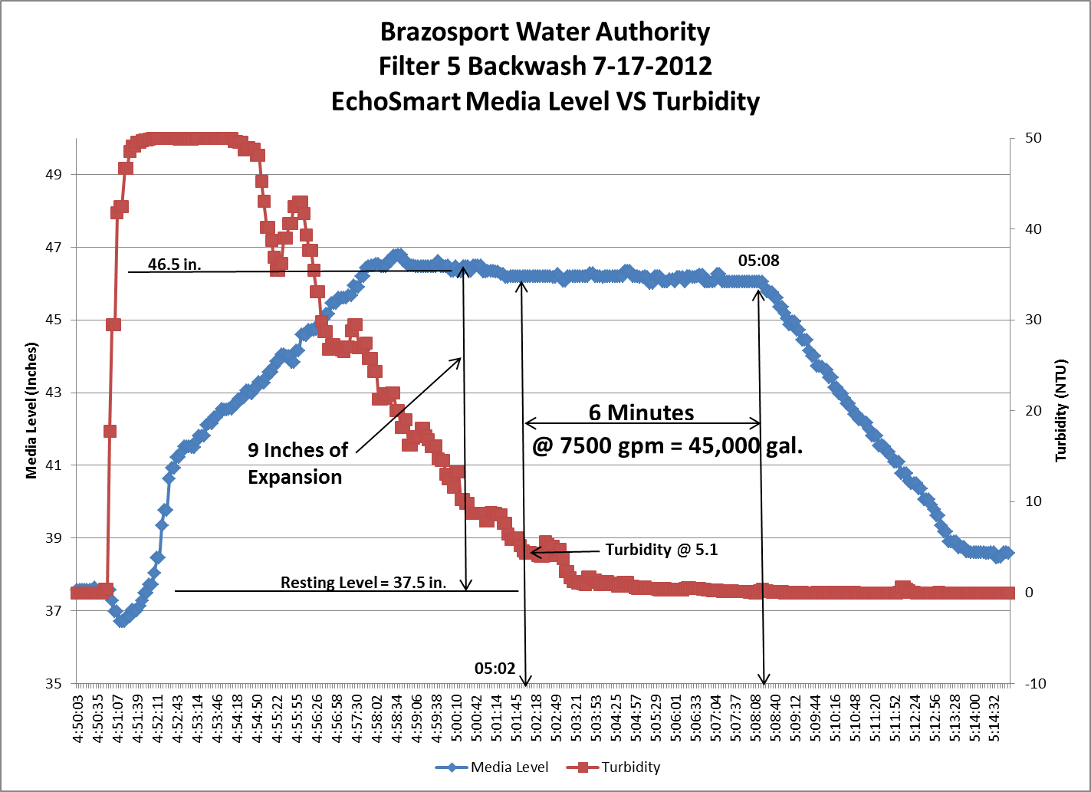
Get The Whole Picture
Smart, Flexible, Friendly!

Slide 39
Percent Bed Expansion
Net
Expansion
Media Depth
Resting
Media
Level
Max
Expansion
Support Structure

Slide 40
Percent Bed Expansion
% Expansion = Net Expansion X100%
Media Depth
Example: Media Depth = 37 inches
Net Expansion = 9 inches
% Expansion = (9*100%) = 24%
37

Slide 41
How Much Expansion is Best?
“A proper backwash rate should expand the filter 20-25%, but expansion can be as high as 50%”
~USEPA Technical Guidance Manual 2004

Slide 42
Turbidity Endpoint
(or, When Does It All Stop!?!?)
“10-15 NTU”
~ Kawamura, 2000
Turbidity left in filter after backwash helps ‘ripen’ the filter and can reduce filter-to-waste

Slide 43
No More Surrogate Measurements
Measure What’s of Interest:
Media Expansion
Turbidity
Smart, Flexible, Friendly!

Slide 44
Questions?
Smart, Flexible, Friendly!

Slide 45
“See” Elements of the Process
Smart, Flexible, Friendly!

Slide 46
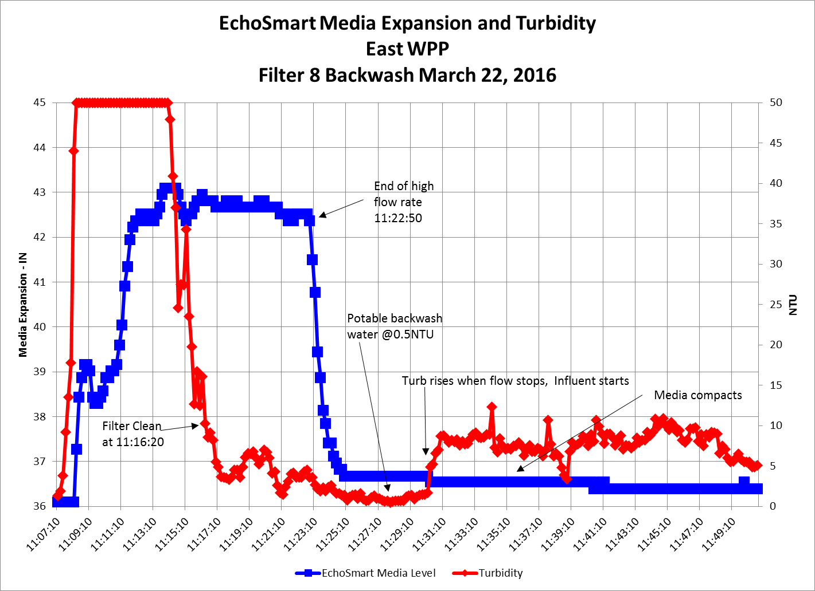
A Most Excellent Backwash Profile
Smart, Flexible, Friendly!

Slide 47
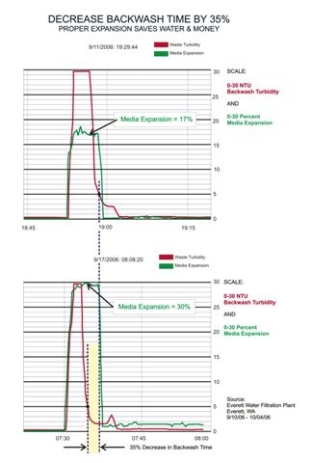
Minimize Turbidity Persistence
Smart, Flexible, Friendly!

Slide 48
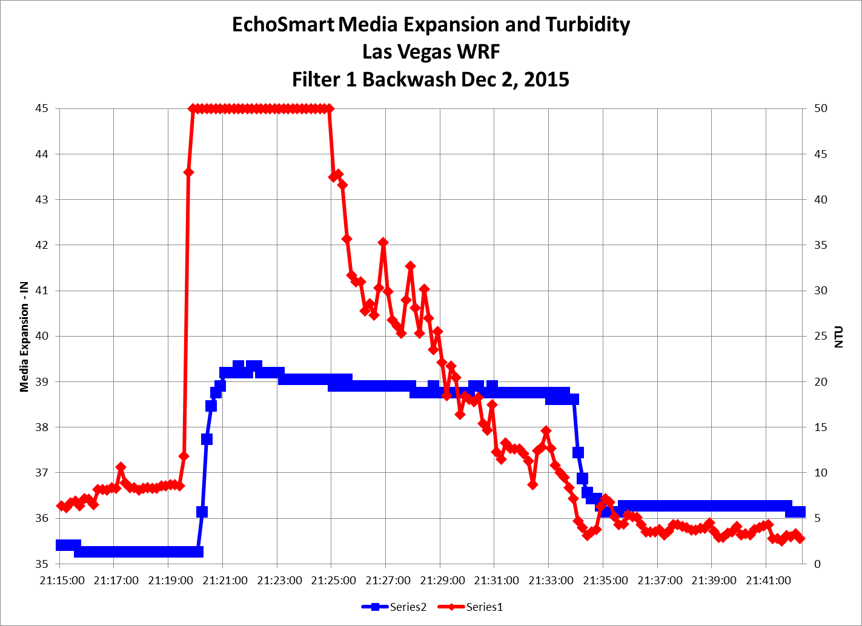
Go High or Go Low???

Slide 49
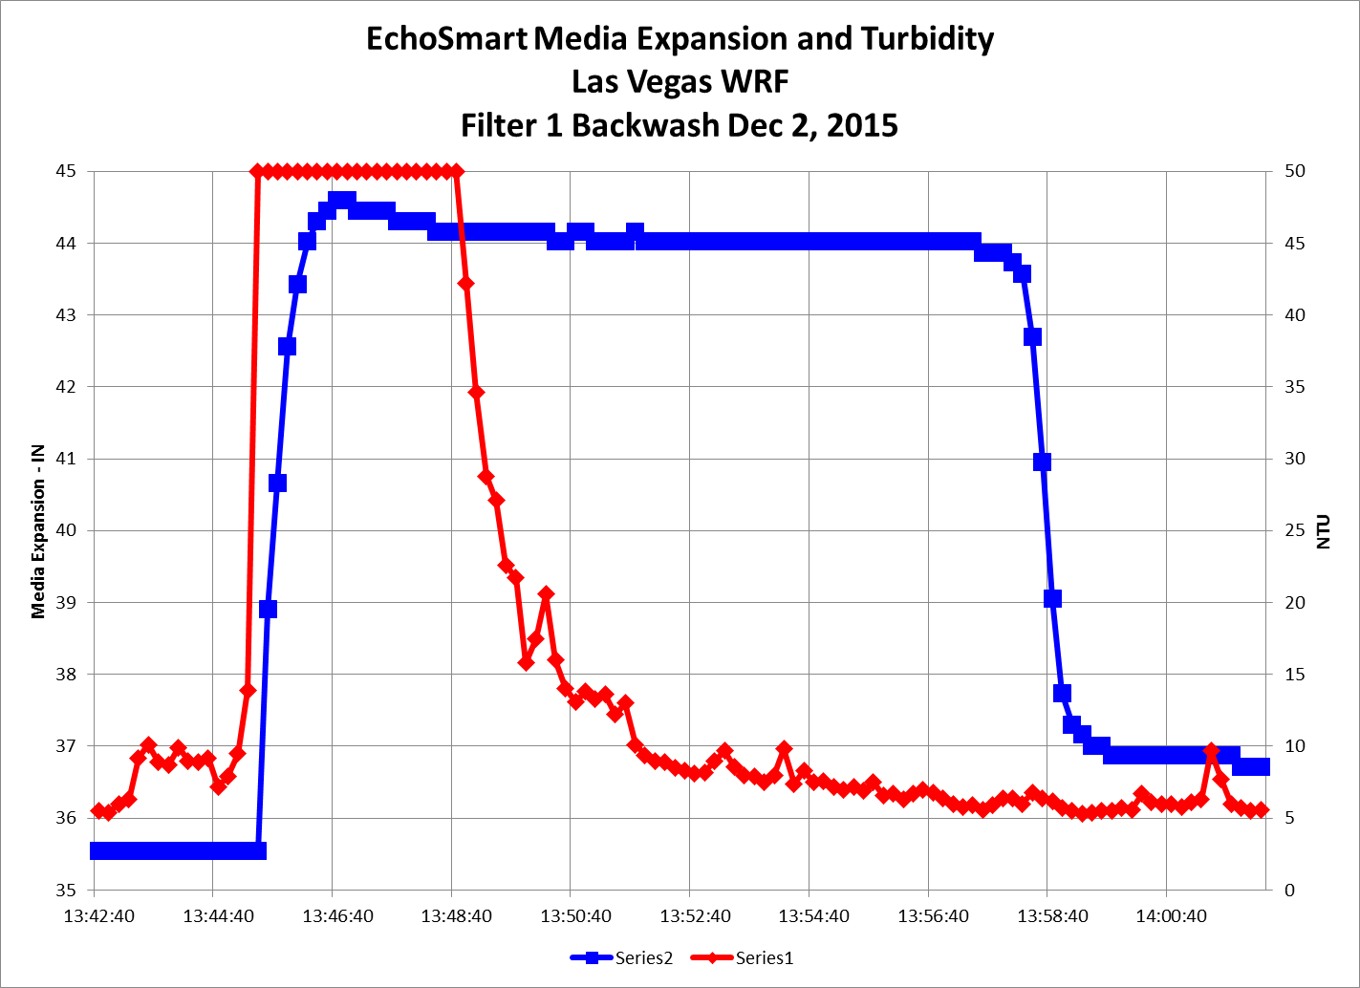
Go High or Go Low???

Slide 50
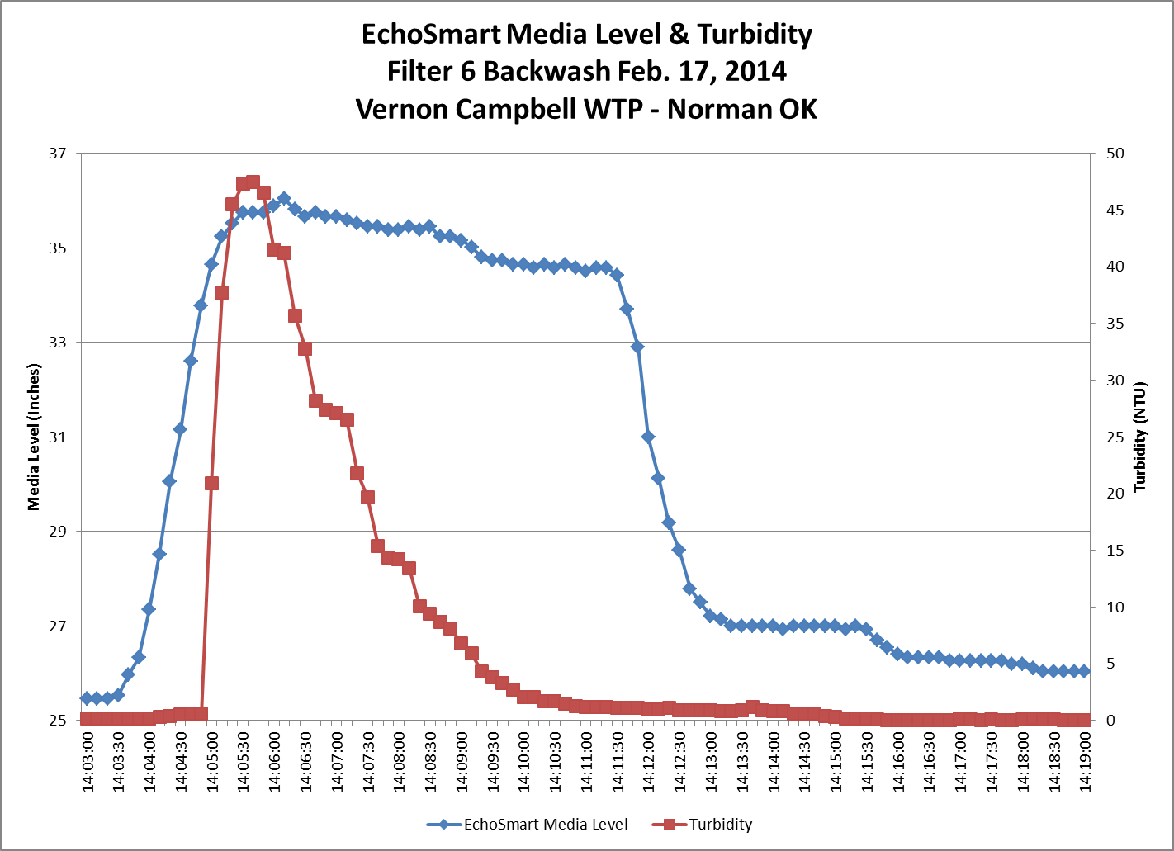
“Conditional” Backwash Control
Smart, Flexible, Friendly!

Slide 51
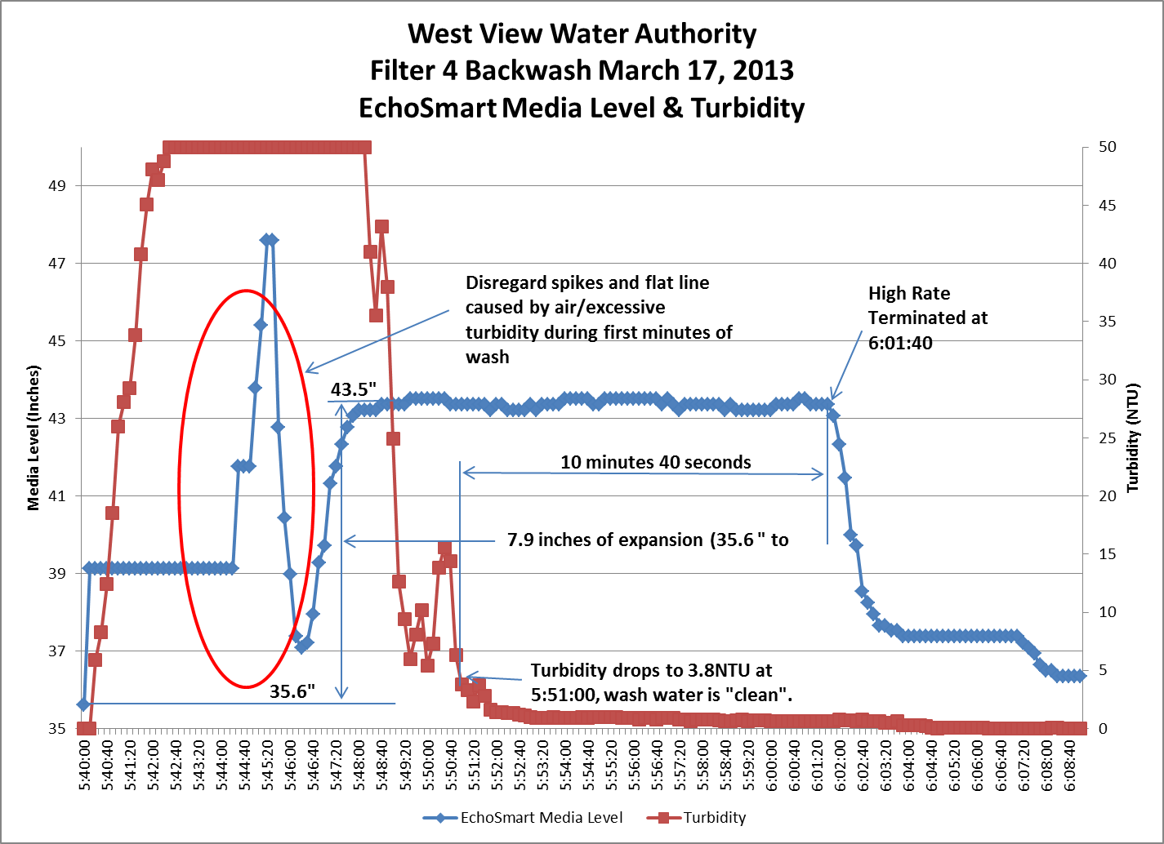
Why Waste H2O? Sell It!
Smart, Flexible, Friendly!

Slide 52
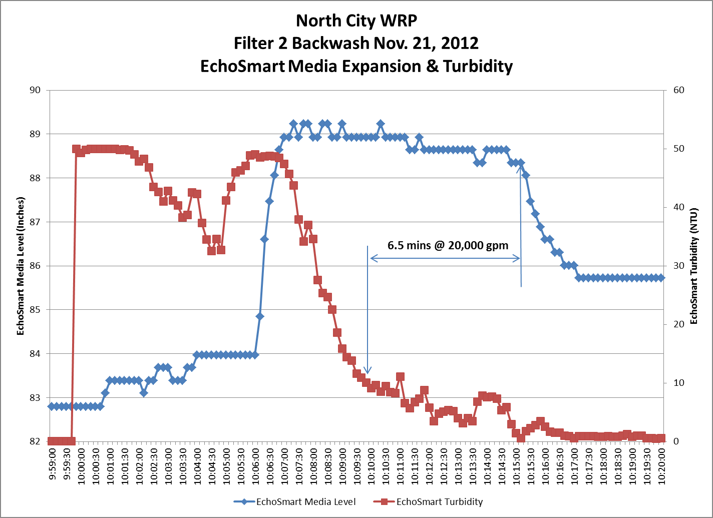
Easy to Calculate Payback
Smart, Flexible, Friendly!

Slide 53
Easy to Calculate Payback
Smart, Flexible, Friendly!

Slide 54
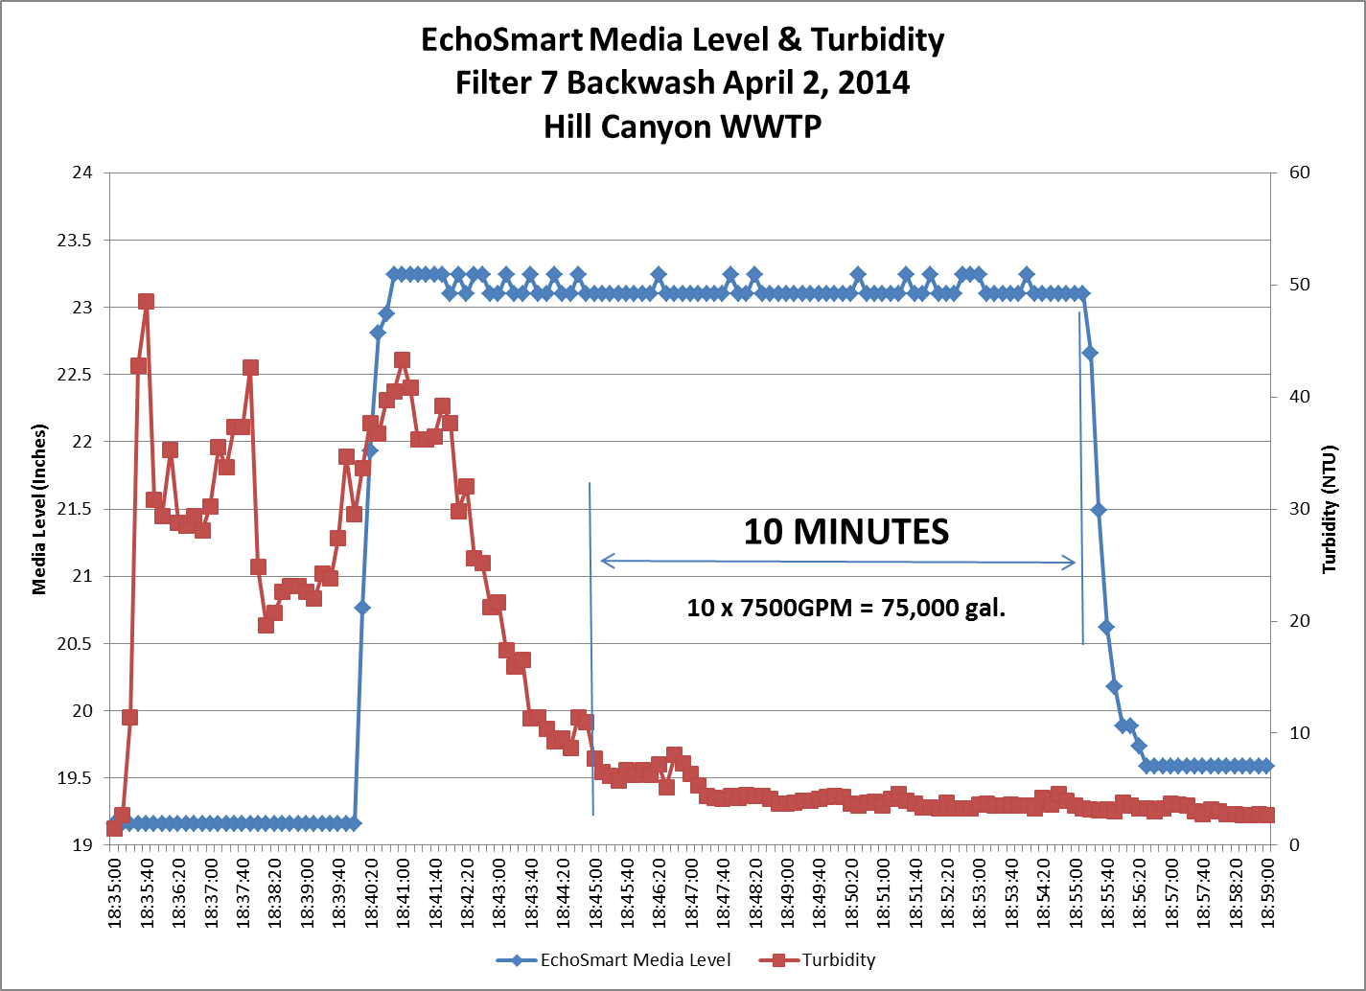
10 Minutes of Overwashing

Slide 55
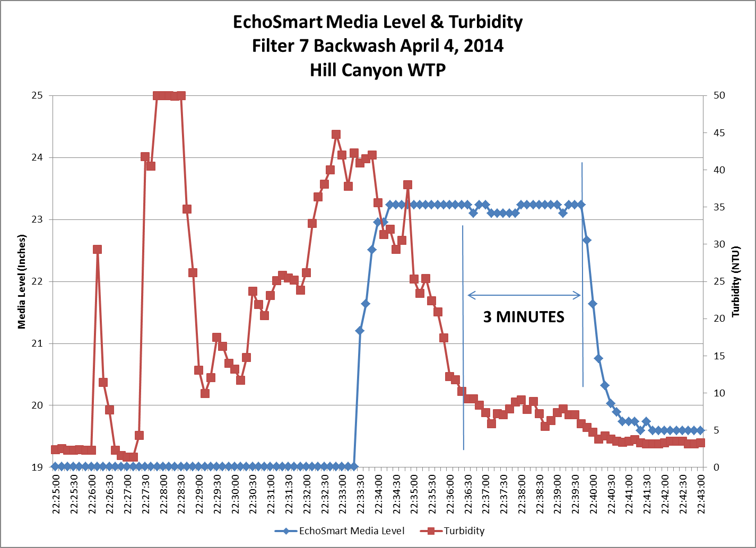
7 Minute Reduction

Slide 56
BW H2O Reduced By Half

Slide 57
Questions?
Smart, Flexible, Friendly!

Slide 58
CASE STUDY
Punta Gorda Florida WTP
10MGD Facility
Two 4-Cell Greenleaf Filters
4 Solids Contact Units
Hi BW Flow Rate = 5,200gpm
Cost of 1000gal = $1.73
Smart, Flexible, Friendly!

Slide 59
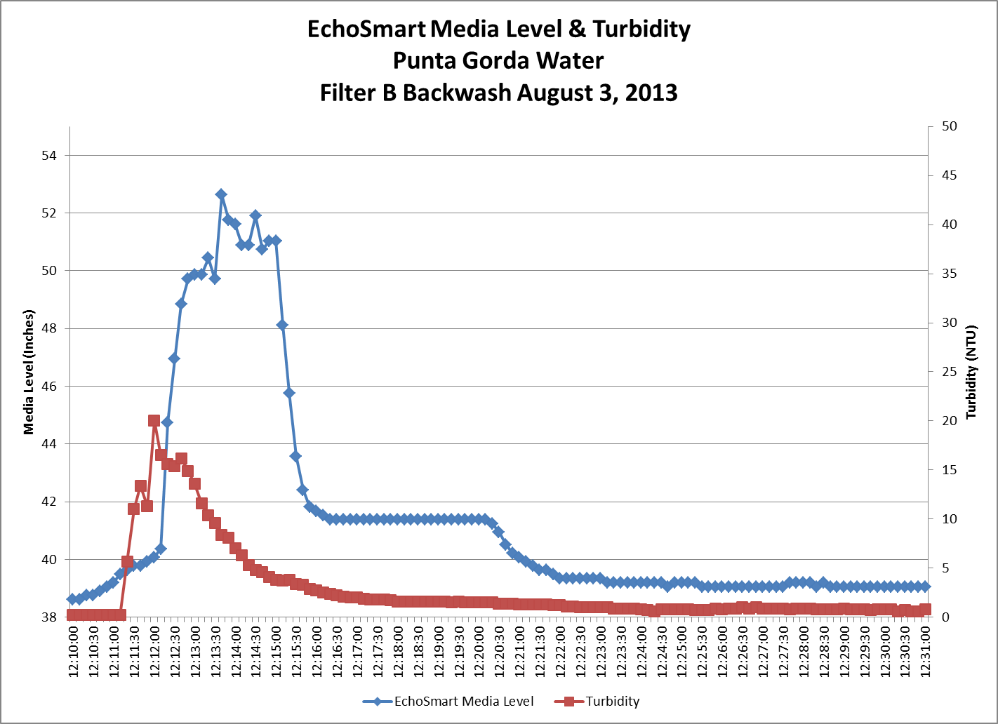
Low Loading? Extend Filter Run!
Plenty of Expansion ~ 37%
Very Little Turbidity

Slide 60
Step One:
Filter Run Times Extended
From 70 to 120 hours
70% INCREASE in Run Time
40% DECREASE in Wash Water Used
$65,000 SAVINGS

Slide 61
Step Two:
Reduced BW Duration by 4 Minutes
(4 mins x 5200gpm = 20,800gal saved per wash)
8 cells washed every 120 Hrs = 584 washes/yr
584 washes x 20,800gal = 12.1Mgal
12.1Mgal x$1.73/1000gal = $21,00 SAVINGS

Slide 62
Step Two:
Reduced BW Duration by 4 Minutes
Before: 90,100Gal Used Each Wash
After: 68,000Gal Used Each Wash
24% Reduction in Backwash Water

Slide 63
Total Savings:
Extending Filter Runs $65,000
Shortening Backwash Cycle $21,000
Total Savings $86,000

Slide 64
But Wait! There’s More!!
Unexpected Benefits in the
Sludge Handling/Drying Process

Slide 65
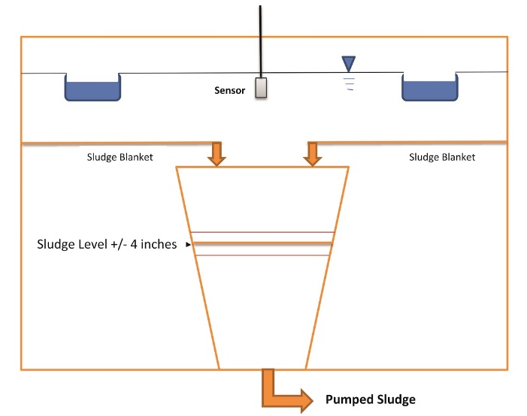
Sludge Handling/Drying

Slide 66
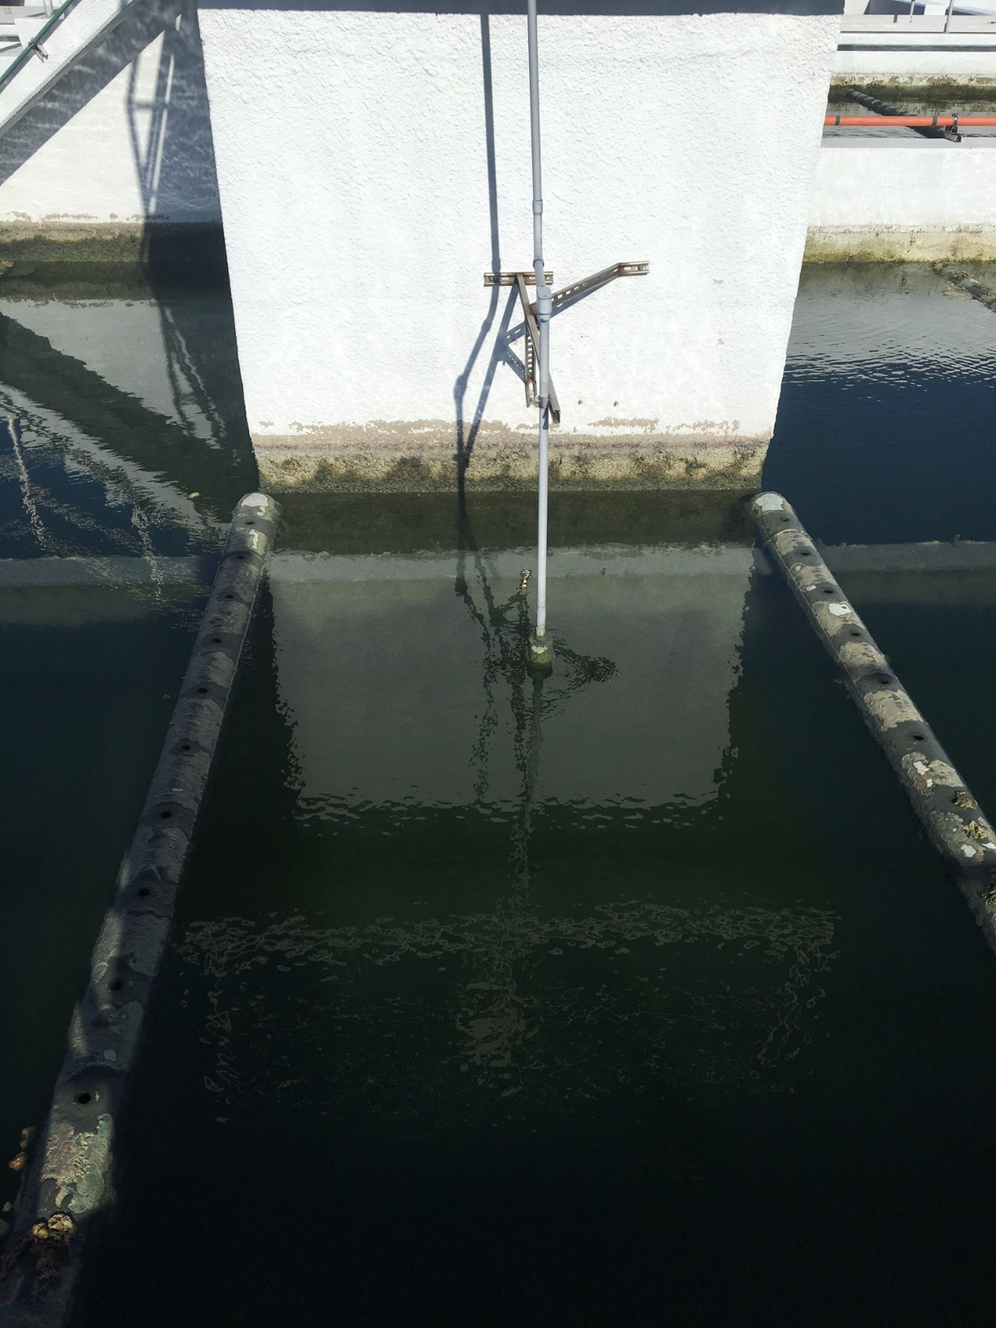

Slide 67
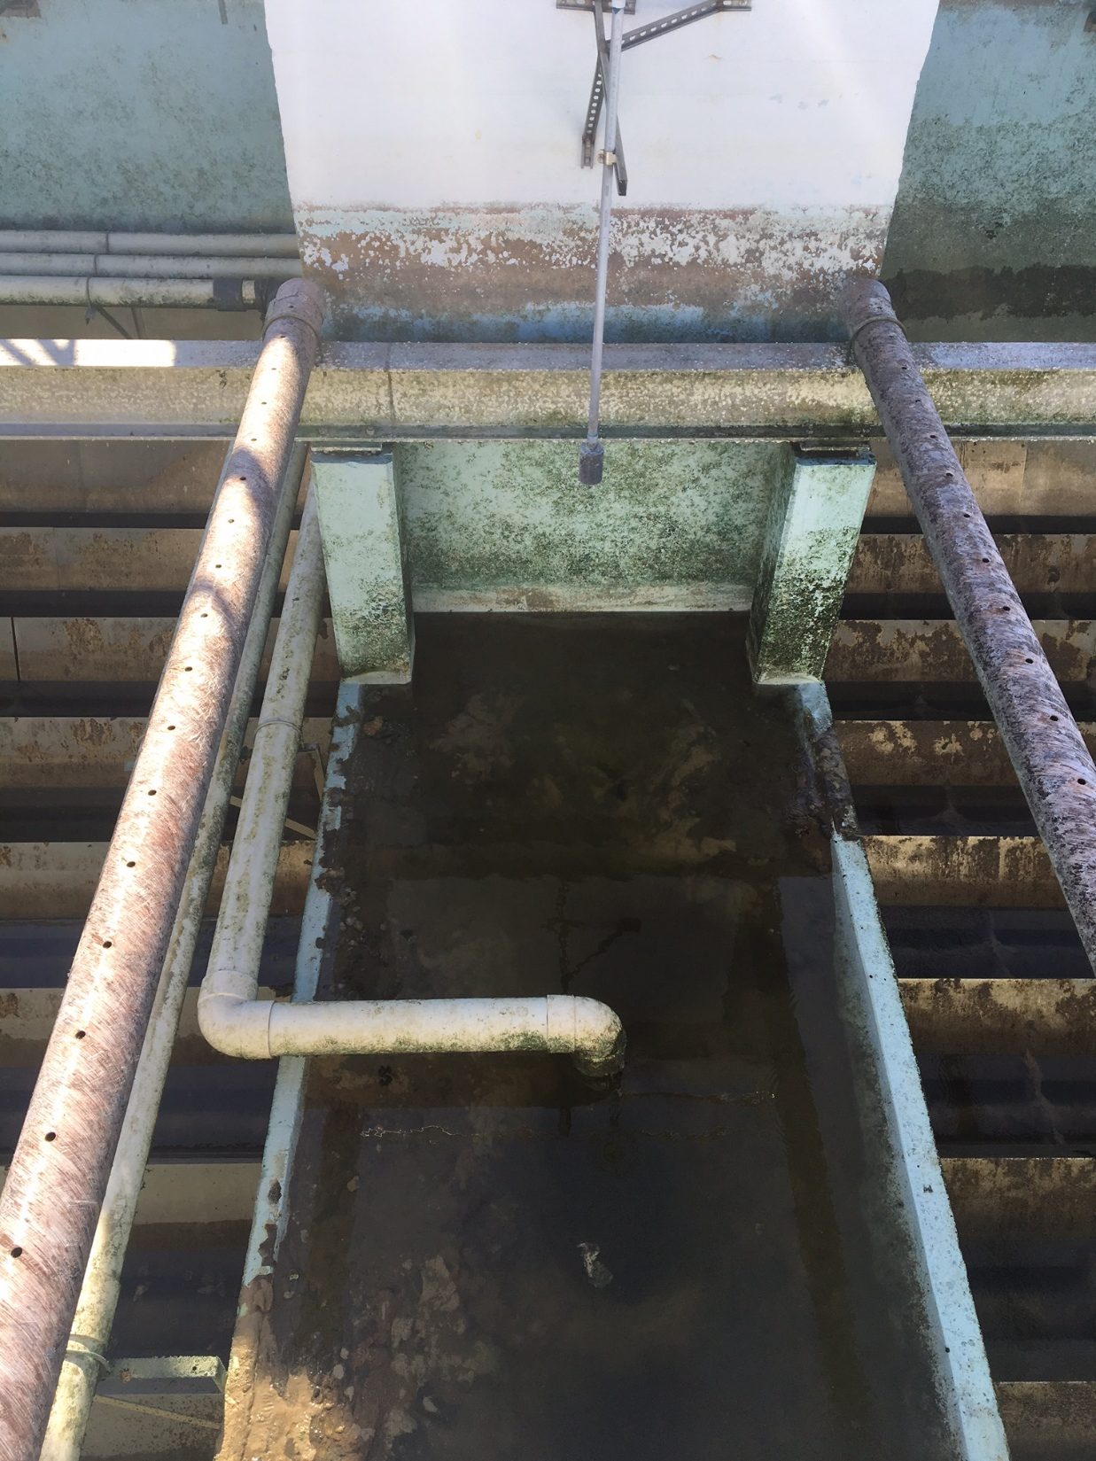

Slide 68
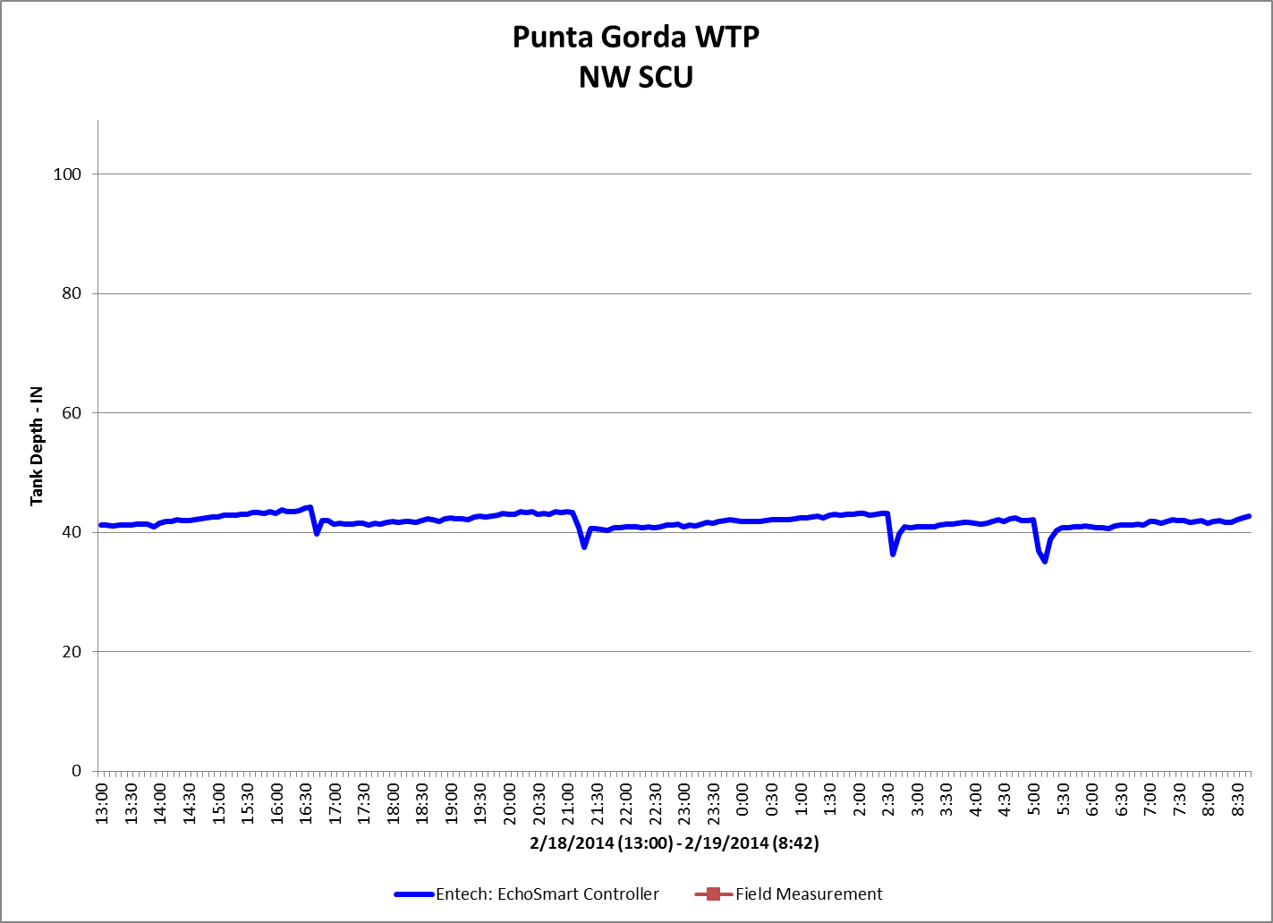
Sludge Handling/Drying

Slide 69
Sludge Handling/Drying
Reduced Pumping Costs
Reduced Hydraulic Loading to Drying Beds

Slide 70
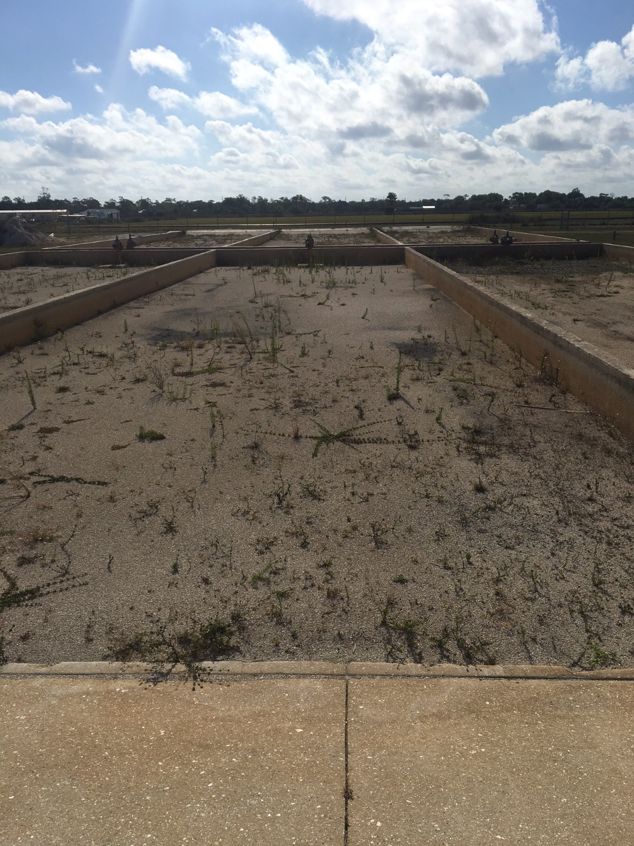

Slide 71
Sludge Handling/Drying
Reduced Need for Sand to Line the Drying Beds
“Haven’t Ordered Sand in Last Couple of Years”
$200-$300K Per Year

Slide 72
Questions?
Smart, Flexible, Friendly!

Slide 73
3 Basic Installation Configurations

Slide 75
Smart, Flexible, Friendly!

Slide 76
Smart, Flexible, Friendly!

Slide 77
Questions?
Smart, Flexible, Friendly!

Slide 78
Remote Monitoring via Cell Modem
Cellular Modem in the Controller
All Settings Available for Remote Startup
24/7 Secure Access to All Sensors in the Network for Monitoring & Support
Loaner Units Available
Smart, Flexible, Friendly!

Slide 79
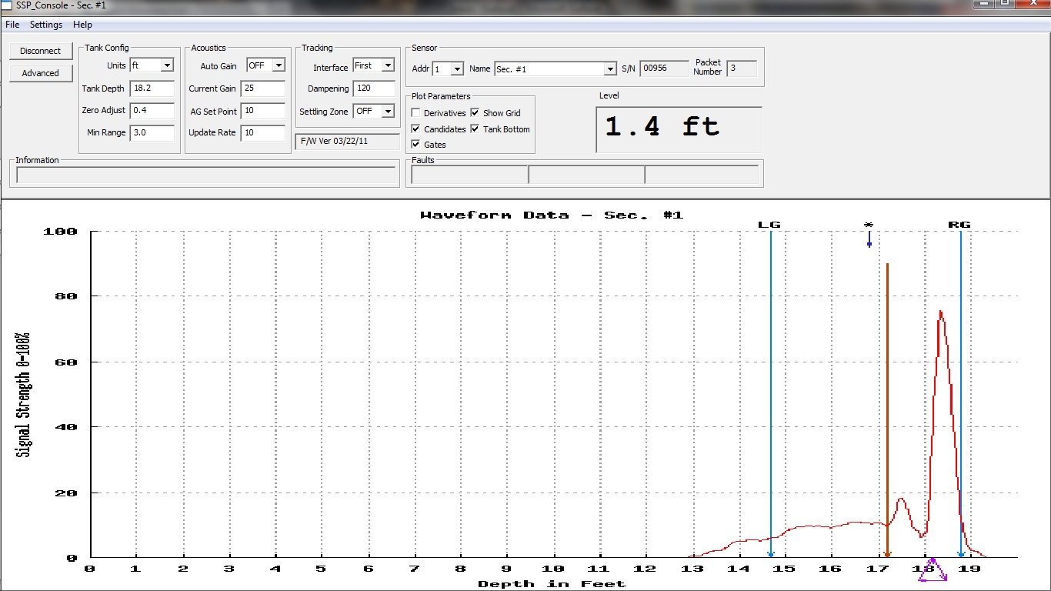
Smart, Flexible, Friendly!

Slide 80
Questions?
Smart, Flexible, Friendly!

Slide 81
Thank You!
ATI-Entech Design Products
Local Representative:
Gilson Engineering
Smart, Flexible, Friendly!

